Slide 1

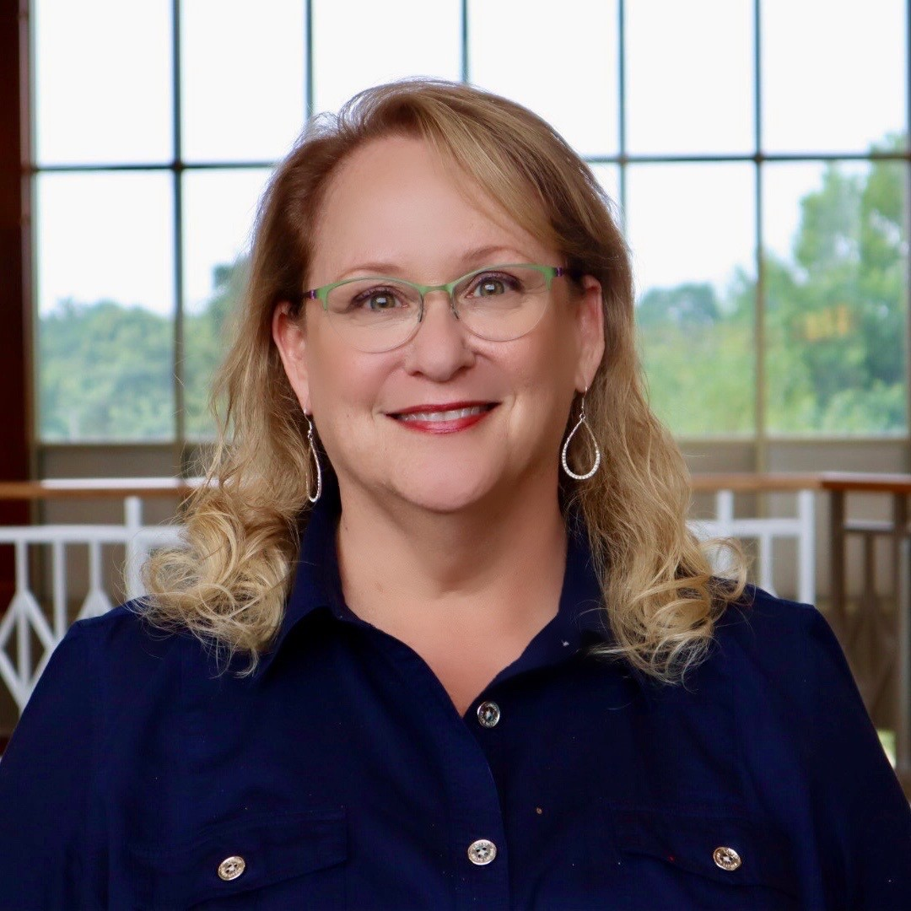
Epilepsy Alliance America Board Chair Liza Gundell

Slide 2










Our Current Member Organizations
Founding Members
Members
Notes:
Some of these organizations are members of the Epilepsies Action Network on their own, and others are not.
We currently have 18 active member organizations.

Slide 3
Why did we lean into the National Plan?
Epilepsy Alliance America doesn’t have the capacity to lead advocacy efforts, but we have the ability and capacity collectively to be leaders in advocacy.
In a community that doesn’t always work together, this is one thing we can all get behind to lift up the entire epilepsy community.
We don’t have to be experts in the plan. We are expert in sharing epilepsy stories and the epilepsy cause.
Notes:
What inspired you to organize your community to activate around the National Plan?

Slide 4
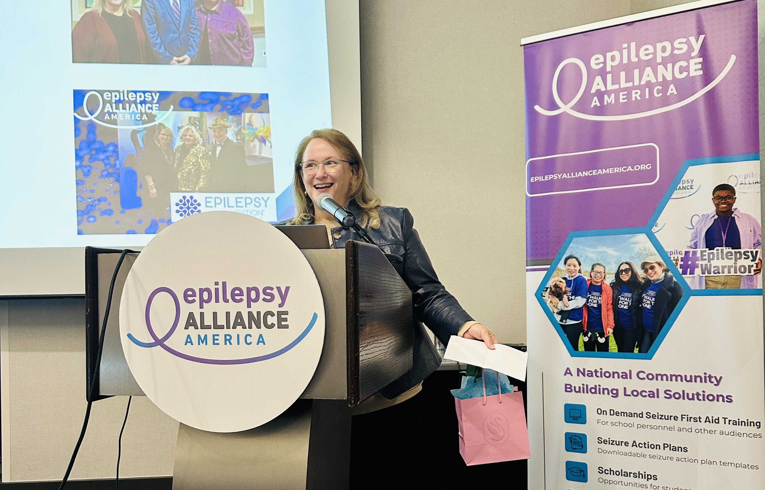
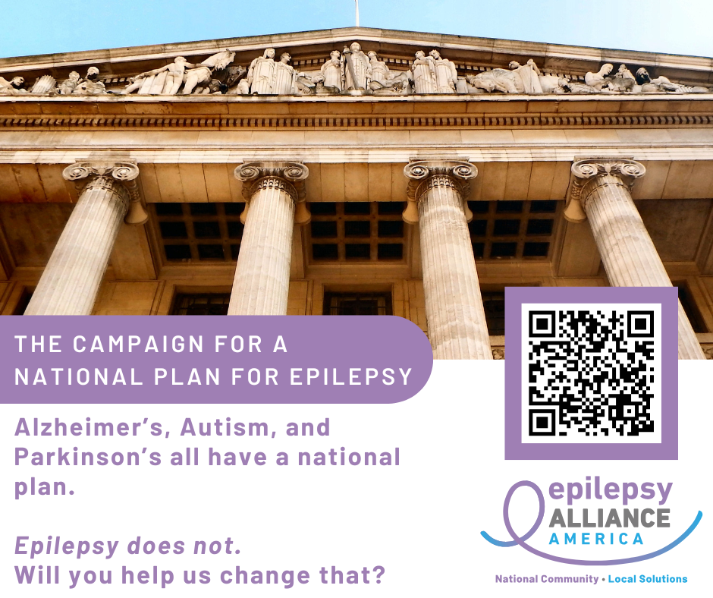
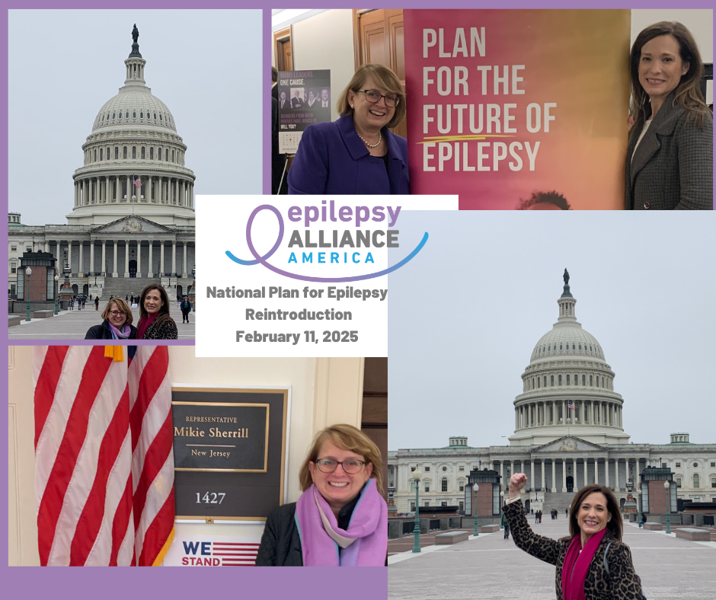
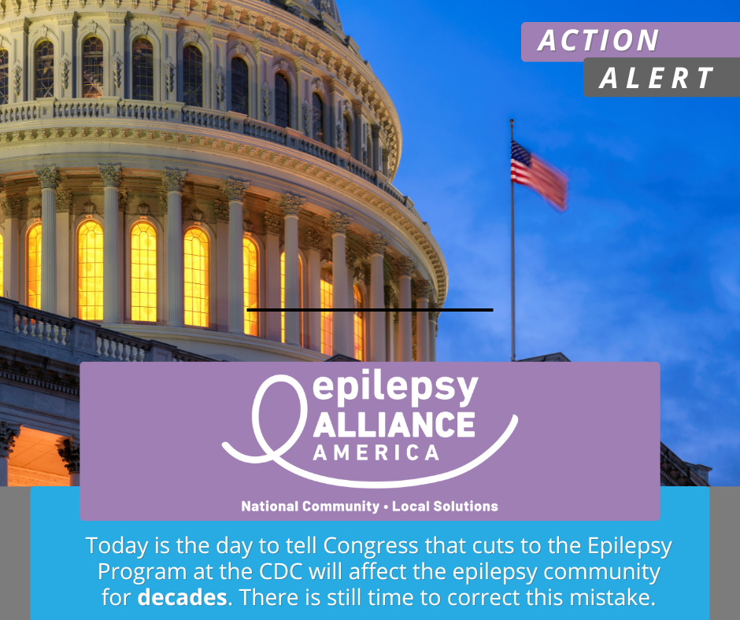
Timeline
2024
Formed Advocacy Committee
January 2025 Stood up Voter Voice
February 2025
Attended NPE Relaunch
March 2025
Announce NPE as a priority
April 2025 CDC Changes
June 2025
Push Week for NPE
Notes:
Were you starting from scratch/"ground zero" or did your org have a history of advocacy?
In 2024, we had planned to make Advocacy a priority for 2025 – we had purchased Voter Voice, formed an Advocacy Committee…..
We decided to lean in to the National Plan for Epilepsy – Lisa Gallipoli and Sarah Dau, Board member for EAA, attended the relaunch in DC (and made visits on the Hill before the meeting and the snow hit!).
In March 2025 we announce at our Member Organization meeting that NPE was a priority and that we had the tools built in Voter Voice to support it for our member organizations.
We had planned to launch a ‘push week’ in May, 2025 – but then the changes at the CDC were announced in early April so we pivoted and put our efforts into alerts and activities around support for the epilepsy program….
And, we did our push week in June, 2025.

Slide 5
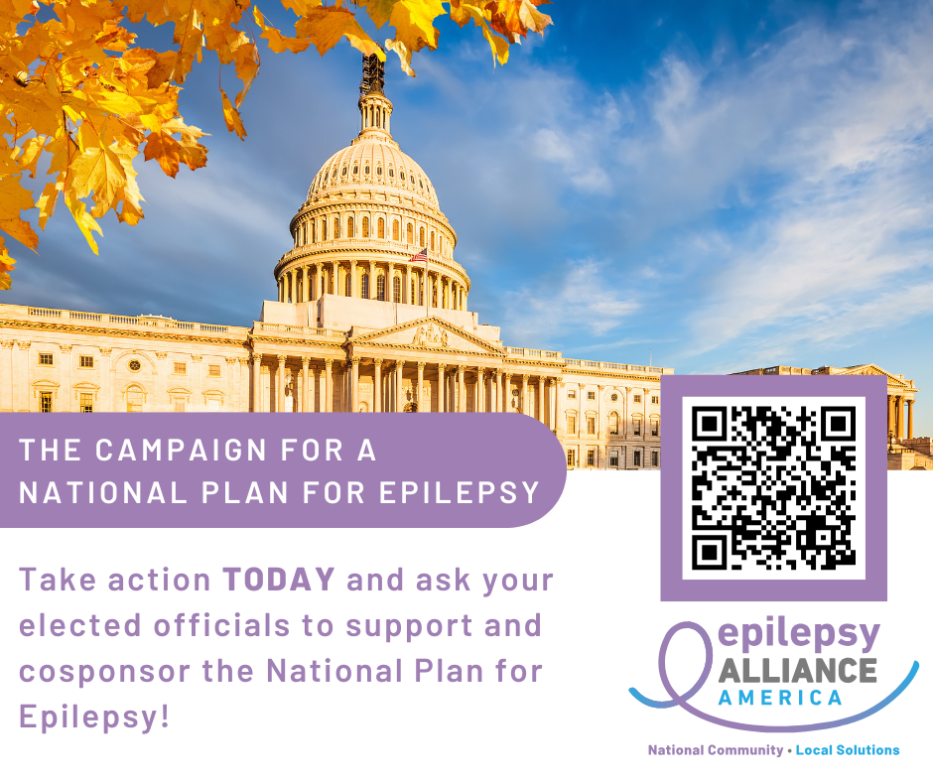
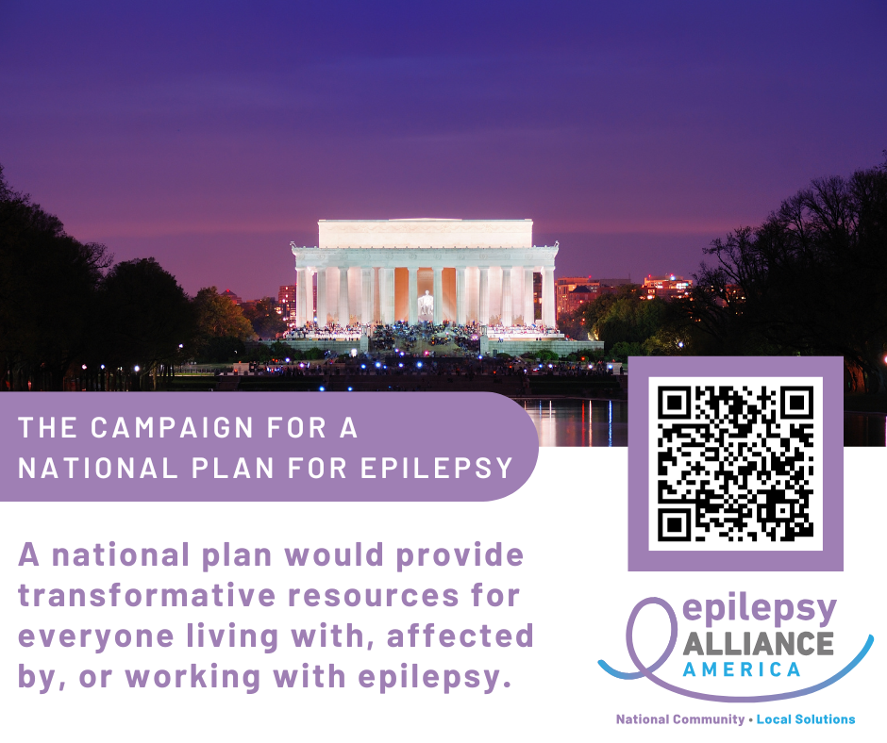
Activities to promote the National Plan
Action Alert built in Voter Voice
Member Organizations of Epilepsy Alliance America have access to the data generated from their geographic footprints
Push Week – June 2025
Dedicated eMail + Social Media Campaign across the Epilepsy Alliance America member organization network
August Recess Visits
Commitment by Advocacy Committee members to schedule visits and include the National Plan
Notes:
What activities did you undertake to promote the National Plan?
Action Alert built in Voter Voice
Member Organizations of Epilepsy Alliance America have access to the data generated from their geographic footprints
Use the same exact language and messages that Epilepsy Action Network provided.
Push Week – June 2025
Dedicated eMail + Social Media Campaign across the Epilepsy Alliance America member organization network
Felt that by doing a ‘push week’ we created some urgency and momentum on an issue that doesn’t always feel urgent.
August Recess Visits
Commitment by Advocacy Committee members to schedule visits and include the National Plan

Slide 6
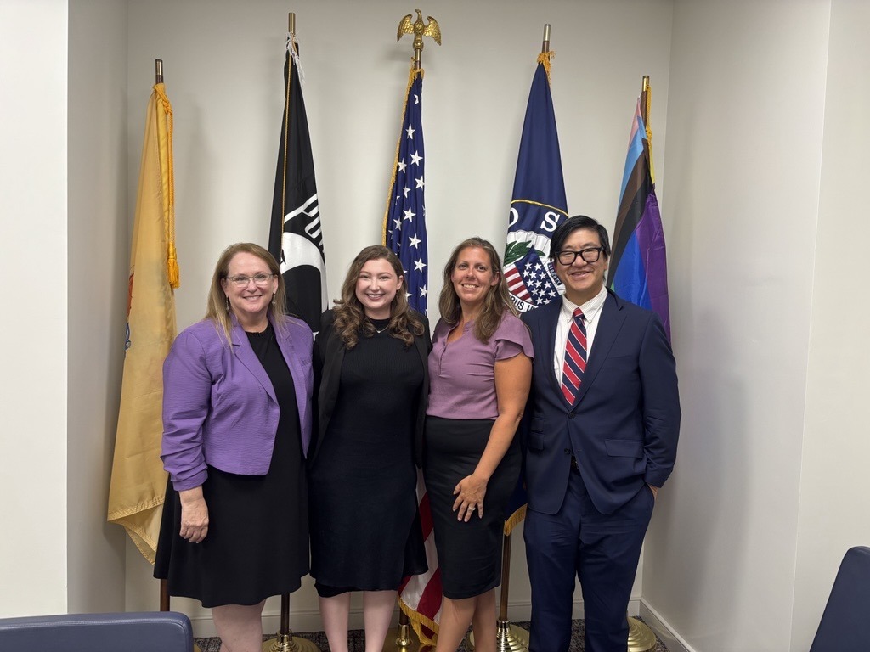
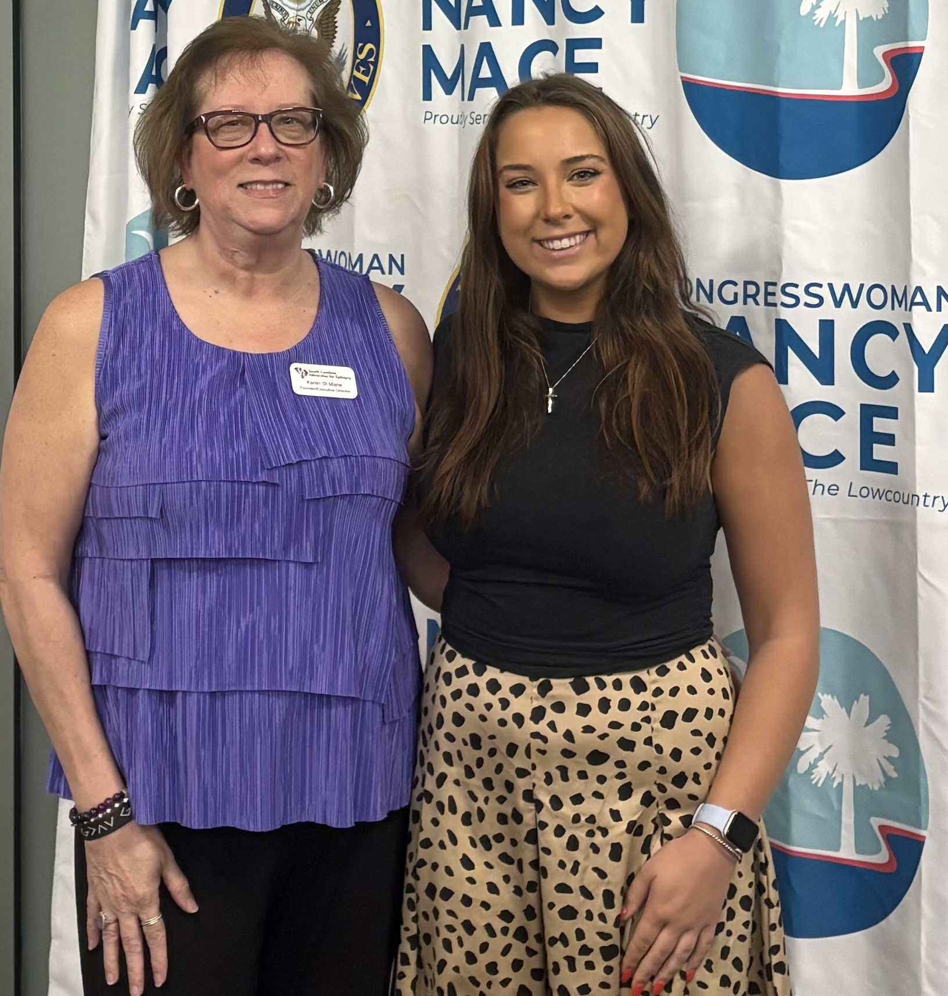
Recess Visits
Epilepsy Services of New Jersey team visit to Senator Cory Booker’s Camden, NJ Office
South Carolina Advocates for Epilepsy (SAFE) visit to Rep. Nancy Mace’s District office
Notes:
Here a few photos from our visits.
And, of course, these photos were also share via social media after the visits, and the members of Congress were tagged.

Slide 7
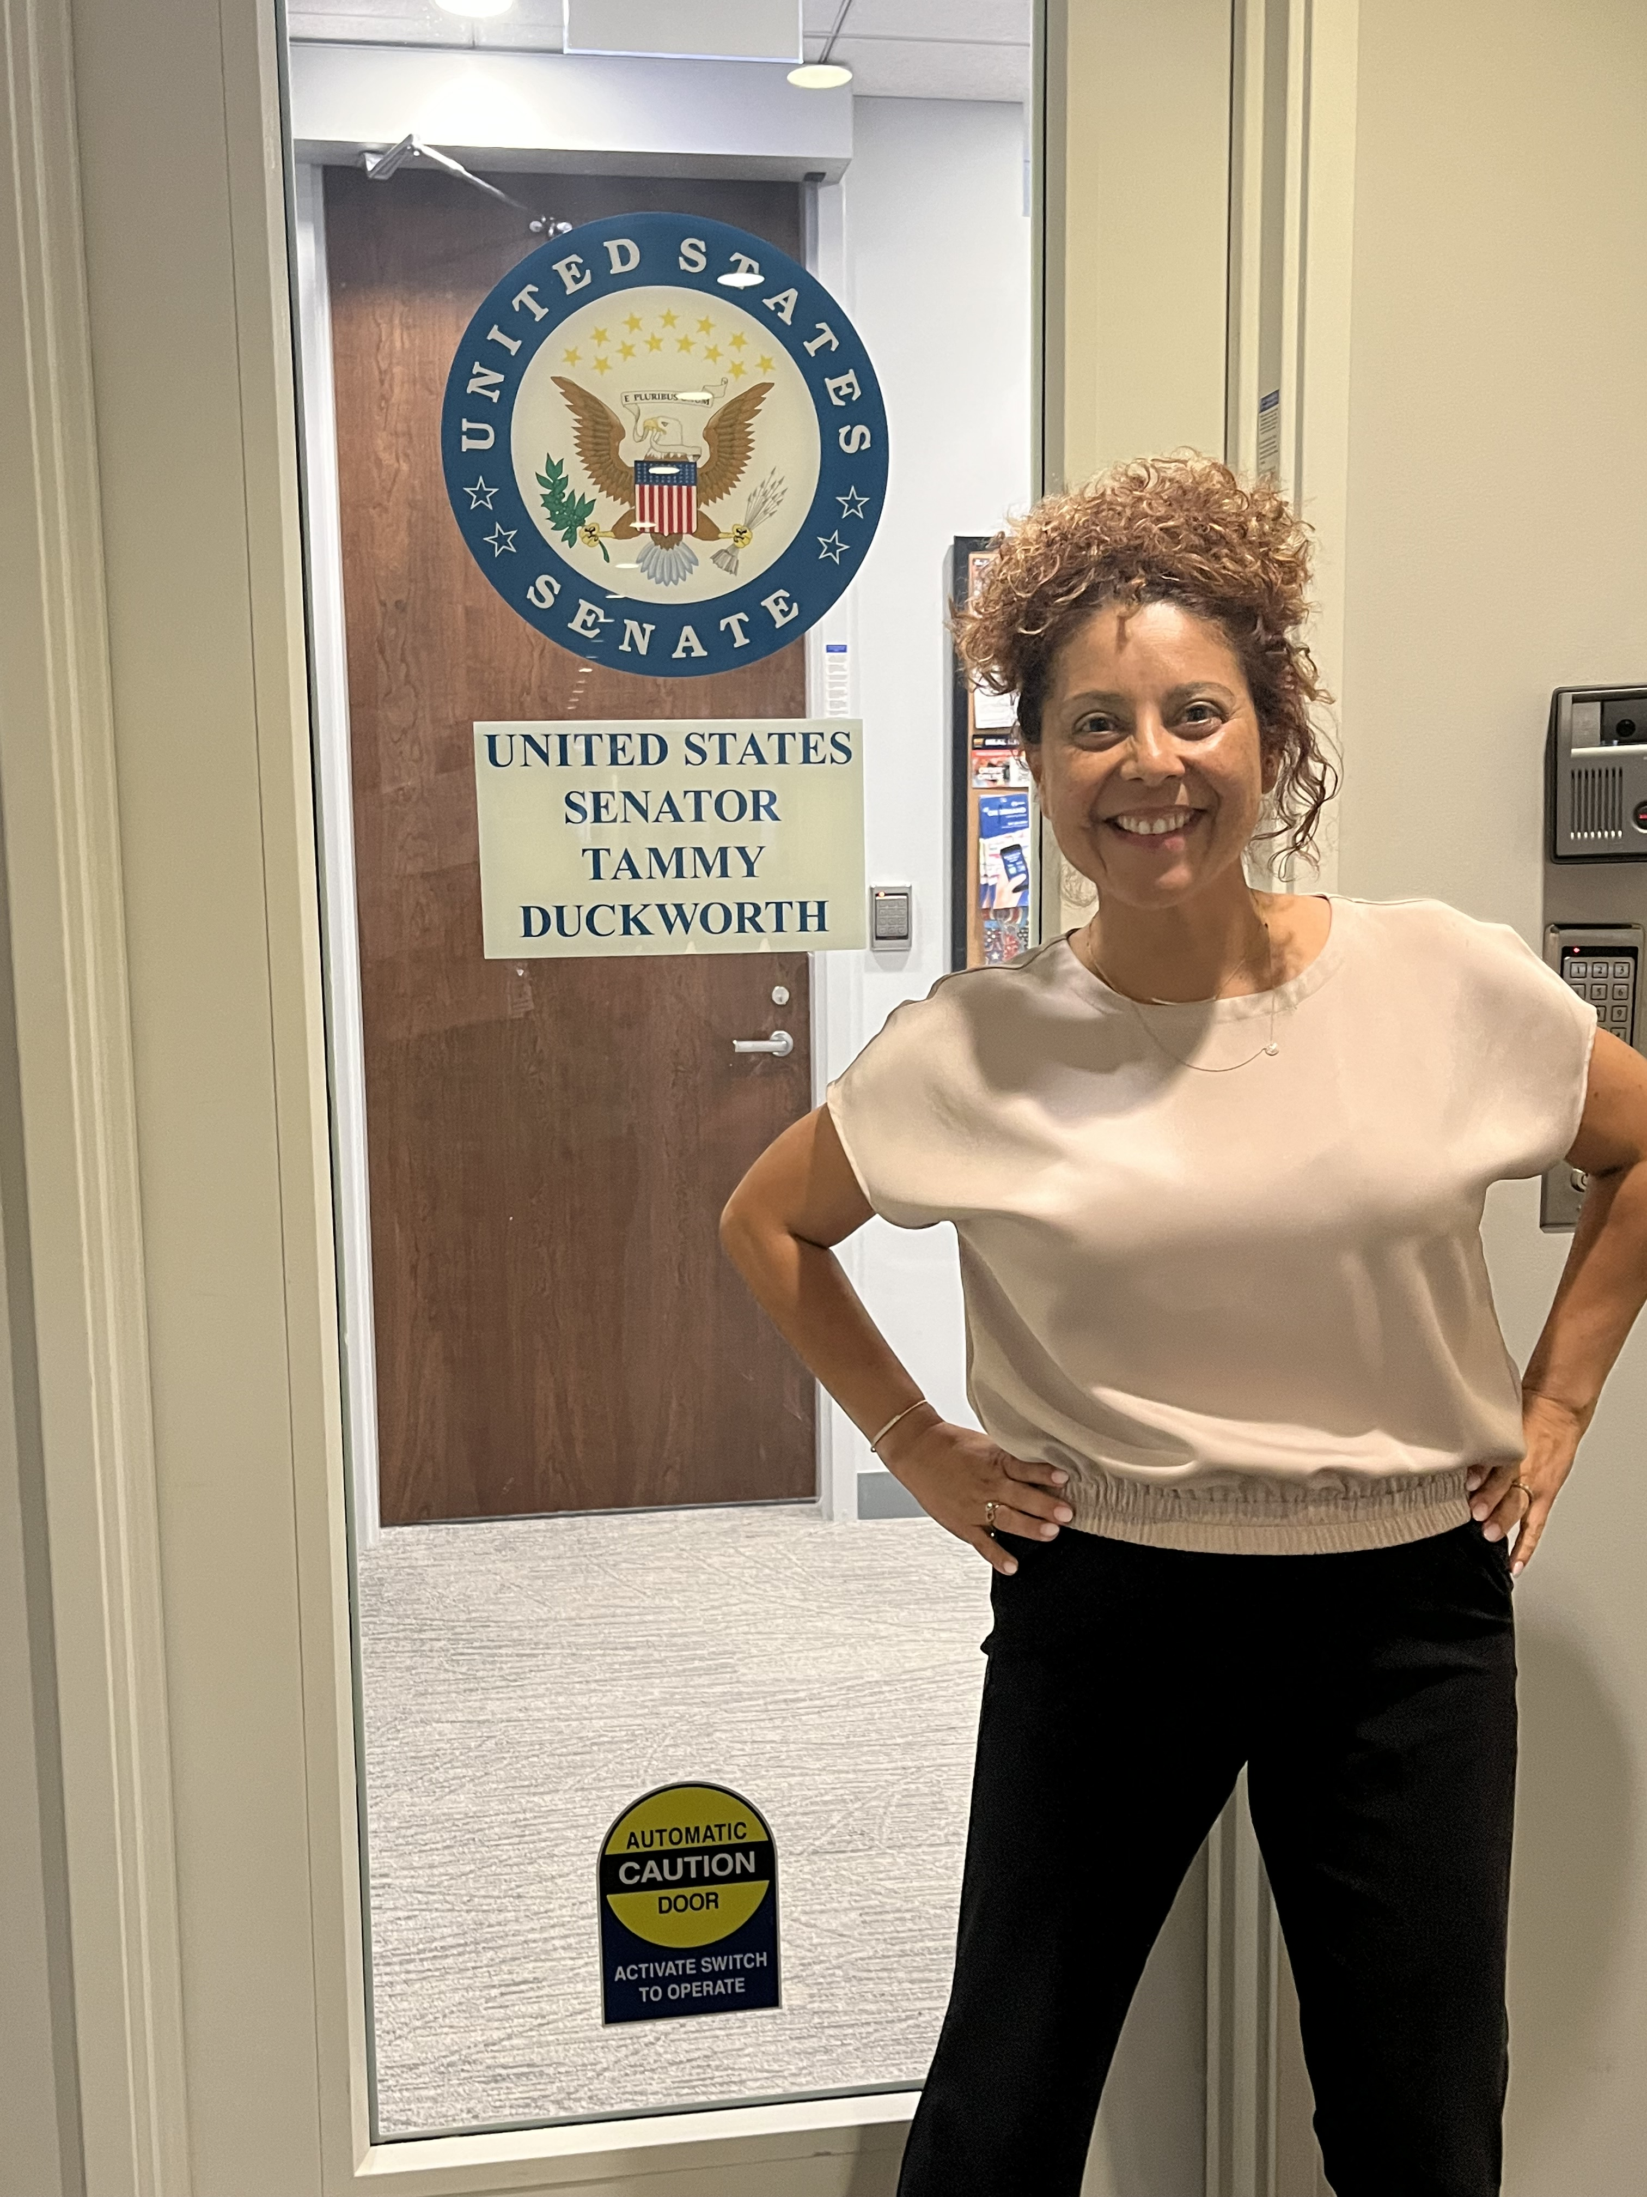
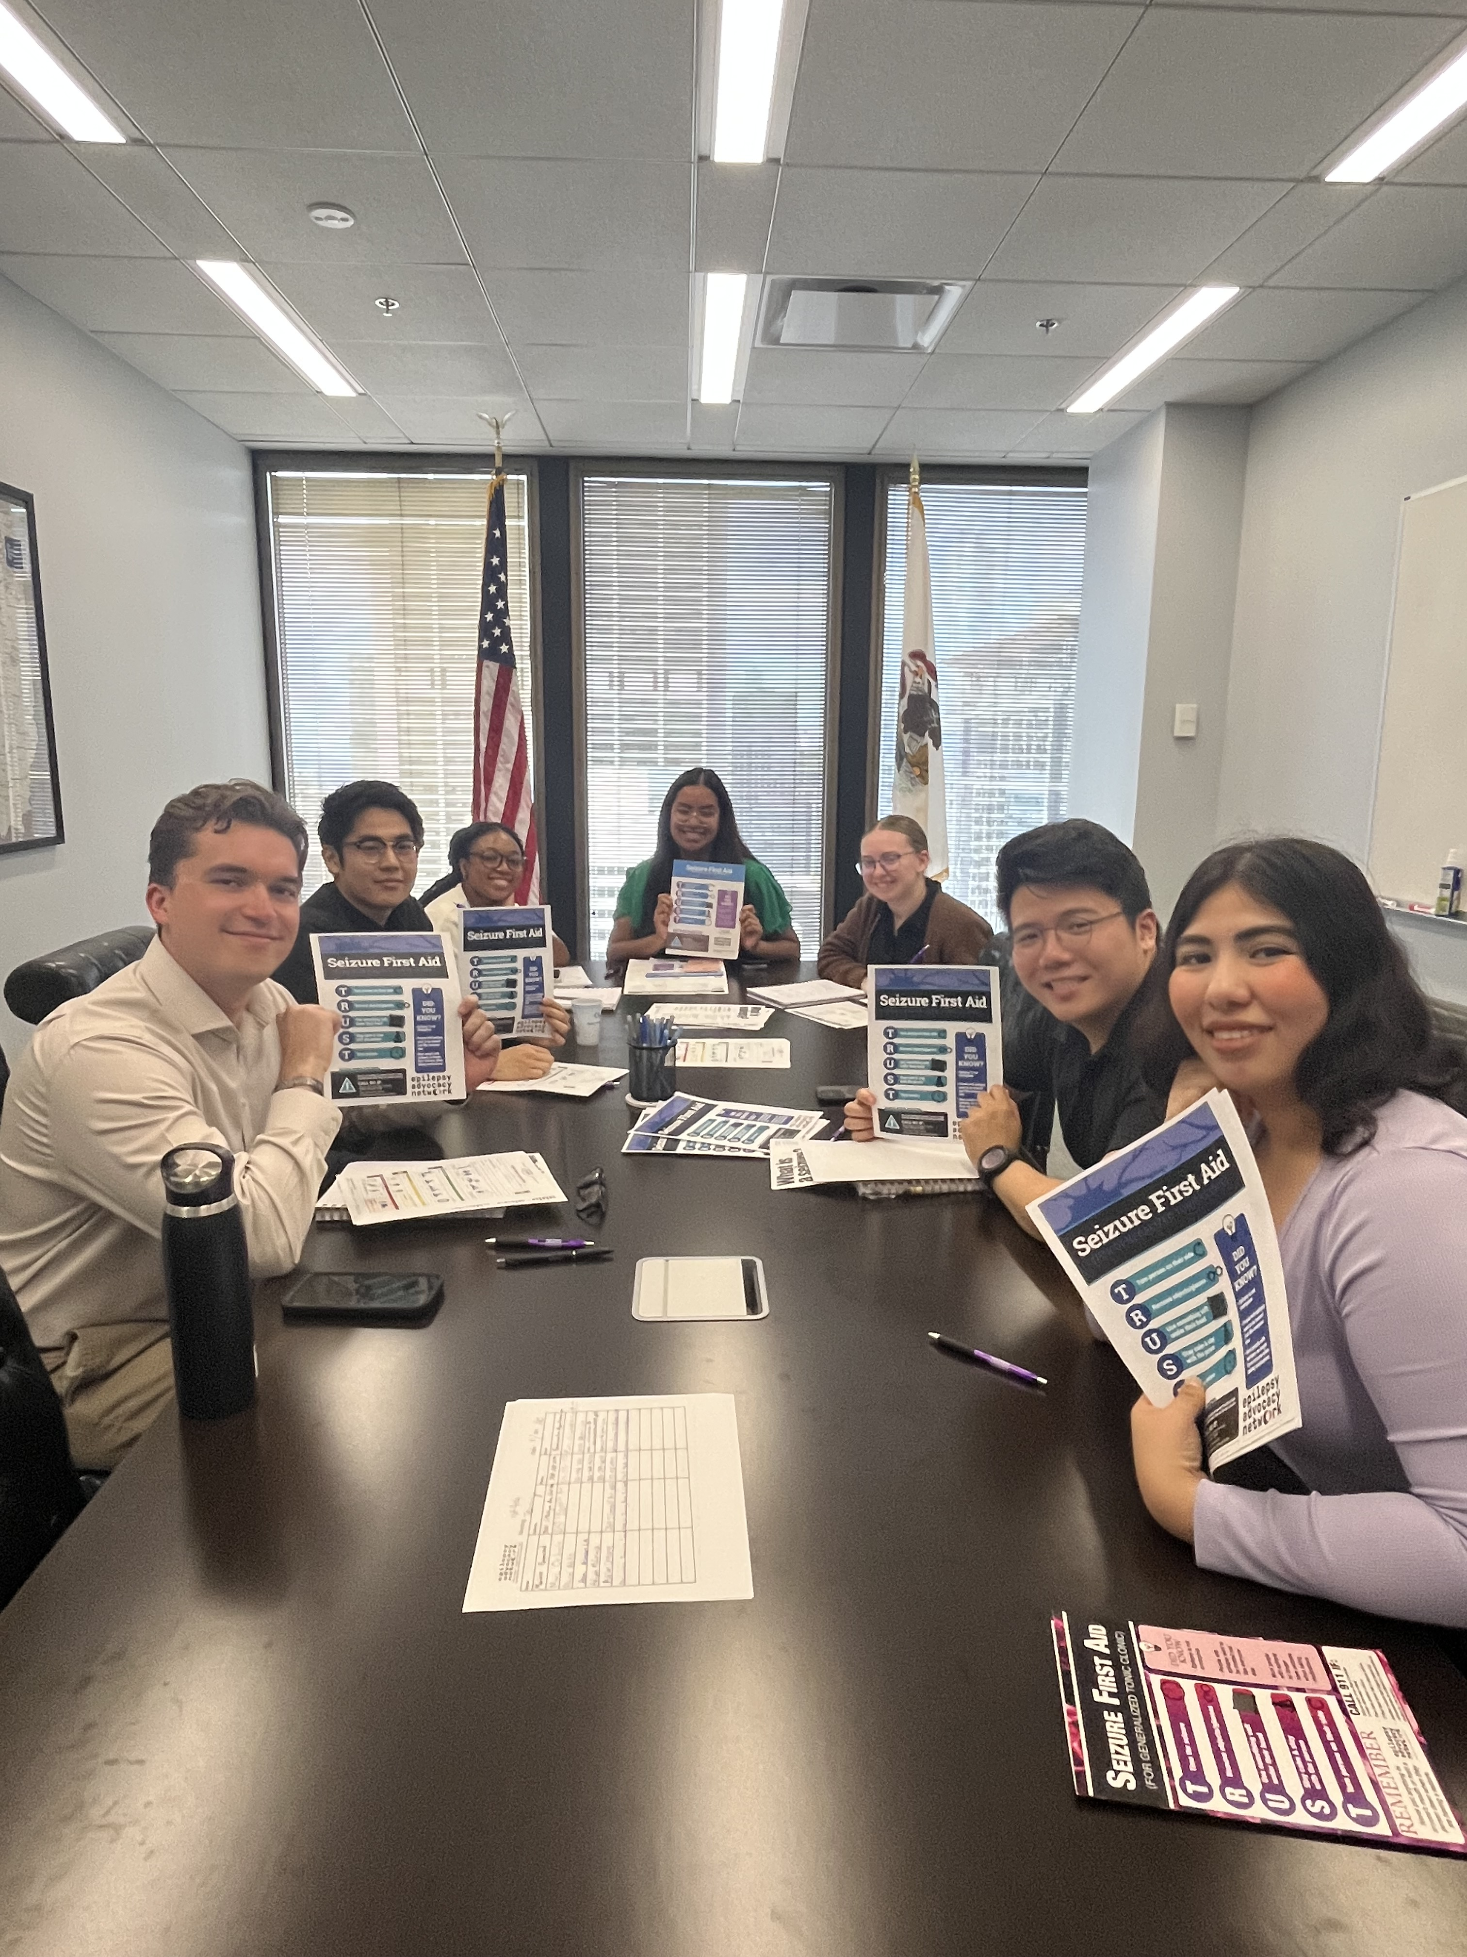

Impact: Seizure Recognition and Response Training
Epilepsy Advocacy Network staff member, Erika Fleck, invited to conduct Seizure Recognition and Response training for Senator Tammy Duckworth staff in Chicago, Illinois
Notes:
What was the impact to the National Plan campaign and your organization internally? (eg legislation Sign Ons, Community Building, Increased Awareness of Your Org/Mission/Priorities)?
Tammy Duckworth Office –
Seizure First Aid Training
(even though she is not signed on to the NPE – yet – because a NO is a no for right now)
Louisiana – learning that a key staffer has a child with LGS.
We know that staff with connections to the mission are often the key to the legislator signing on….

Slide 8
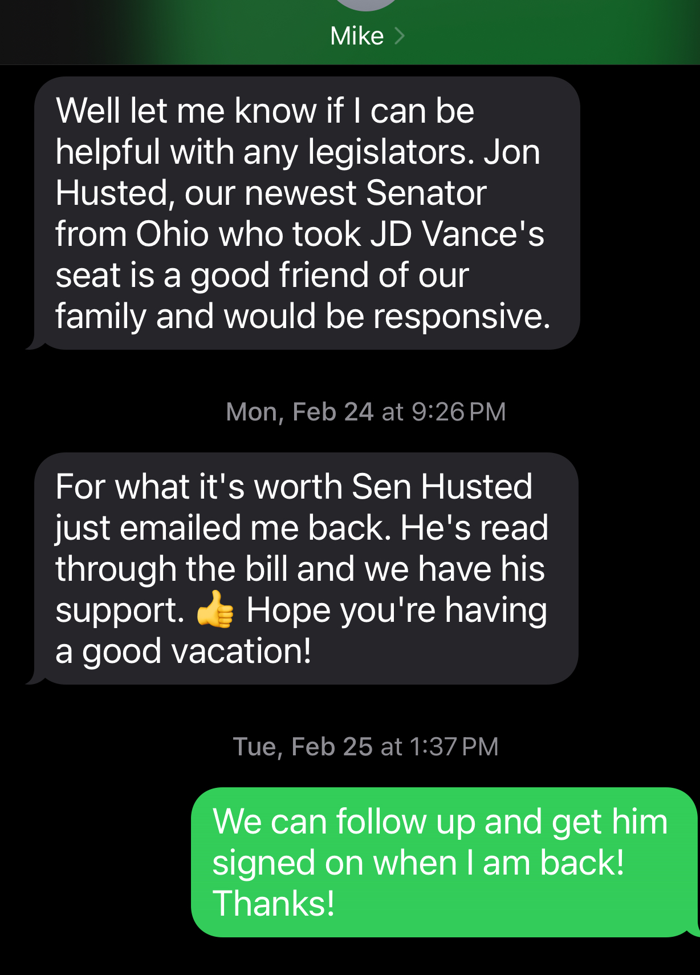
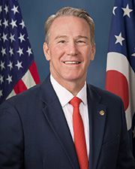
Key Contacts Uncovered
Senator Jon Husted (R-OH)
Signed on to the NPE after ONE PHONE CALL from a family friend who lost their son to epilepsy
He signed on that day!
Notes:
What messages and activities resonated? How did you motivate/inspire your community?
We uncovered Key Contacts where we least expected them….
We actually never talked about the NPE – Mike (our strategic plan consultant) saw our Linkedin post from the NPE relaunch in February….and then he texted Lisa…

Slide 9
Just Do It…
Use the tools and talking points provided
Consistency of message is critical.
Don’t wait for the perfect meeting.
Get the imperfect meeting on the calendar!
Take Notes and Share with the Class
Key Contacts; Questions? Objections. Bring it all back.
Notes:
What advice do you have to share with other organizations who are interested in standing up advocacy activities?
Consistency is important:
In Illinois – 3 organizations, CURE Epilepsy, PAME and Epilepsy Advocacy Network (Il)- all made separate visits to Senators and Representatives - with the SAME MESSAGES. And, people signed on!!!!!
Getting the meeting is hard, and can be time consuming – even for Zoom. Focus on getting the meeting on the calendar – then assembling constituents in their district to attend. You will save time and energy!
Take Notes – this is a cumulative process – each visit builds on the next – whether it’s the same constituent or a different one with the same message – knowing what the objections have been prepares you to overcome them – knowing that someone in the office has a personal connection to epilepsy can get you in the door faster.

