Slide 1
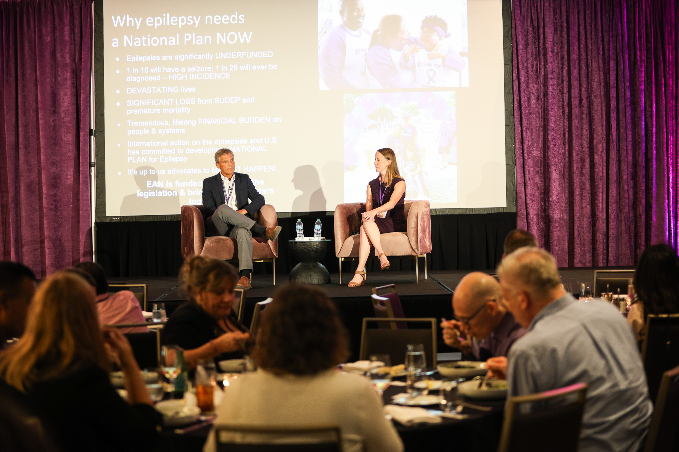
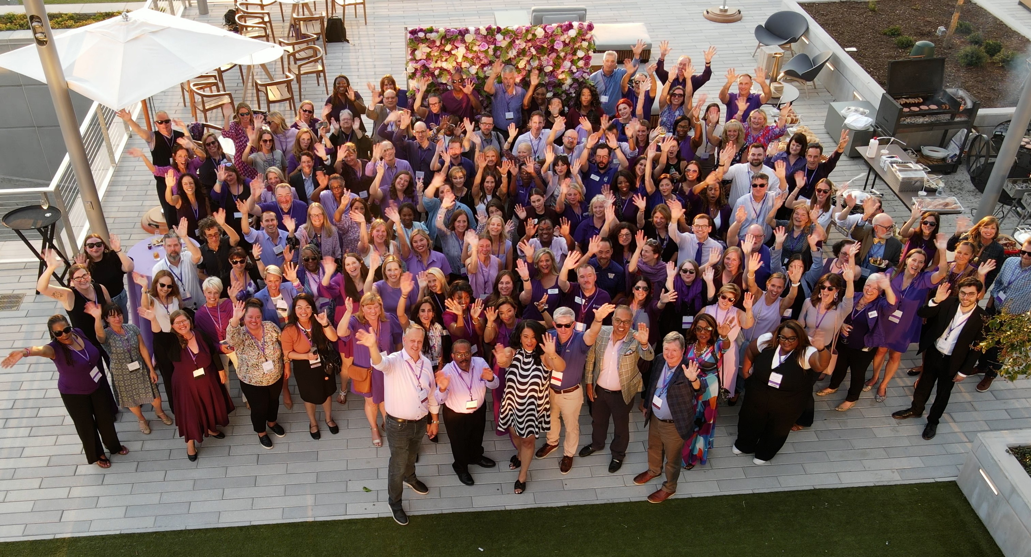
Advocating for the National Plan for Epilepsy
EFA on EAN’s Steering Committee
EFA’s Annual Policy Priority Setting
Education of EFA’s Network & Advocates
Notes:
Advocacy has always been a core mission area of EFA.
EFA is on EAN’s Steering Committee so has been involved in development and introduction of the legislation
We were already very on board, but still had to put it through EFA’s typical process. We have a committee made up of PWE, family members, HCPs, and EF staff who help us pick our annual federal and state policy priorities—so made sure to discuss the national plan with them and formally get it on EFA’s policy agenda.
EFA worked to educate our local offices and advocates across the country, letting them know the national plan was in the works and that EFA would be advocating for it alongside many community partners. Including talking about it on our monthly state advocacy leader meetings and at EFA’s leadership conference in Sept 2024.

Slide 2
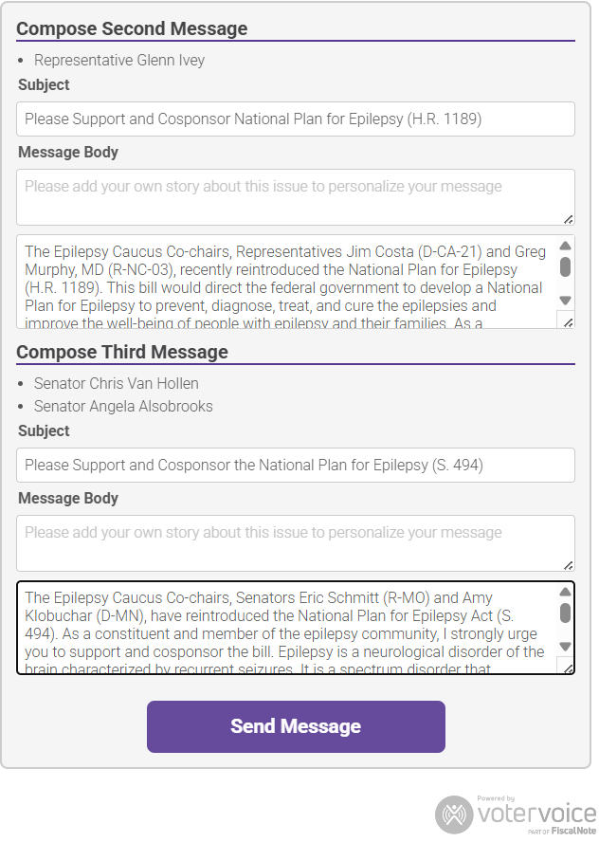
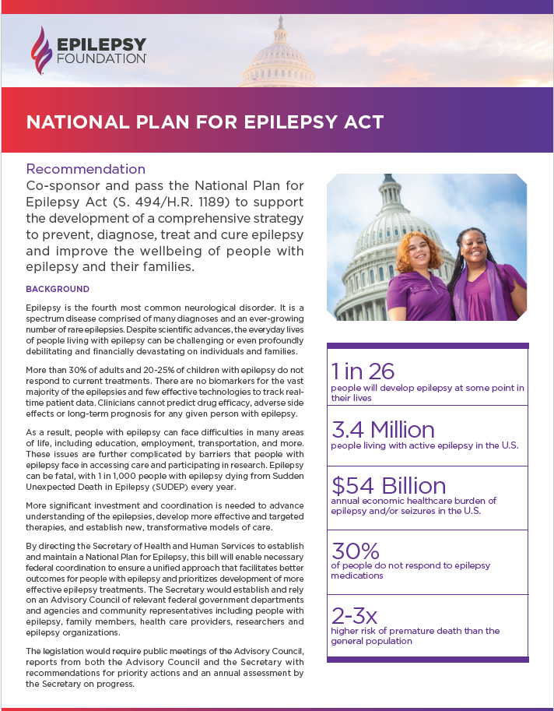
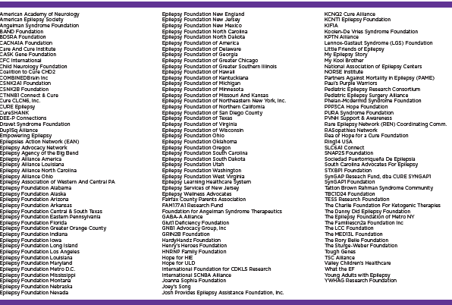
Resource Development
Notes:
Developed resources; helped make the non-branded position paper and then put it on EFA’s template. Back always lists the partner organizations that have endorsed the bill—to show it is a community-wide effort.
EFA has an action alert system that allows people to personalize a message and easily send emails to their elected officials—in this case, asking their members of Congress to cosponsor the national plan. EFA has made this system available to the entire community and/or orgs can use the same wording and use their own system.

Slide 3
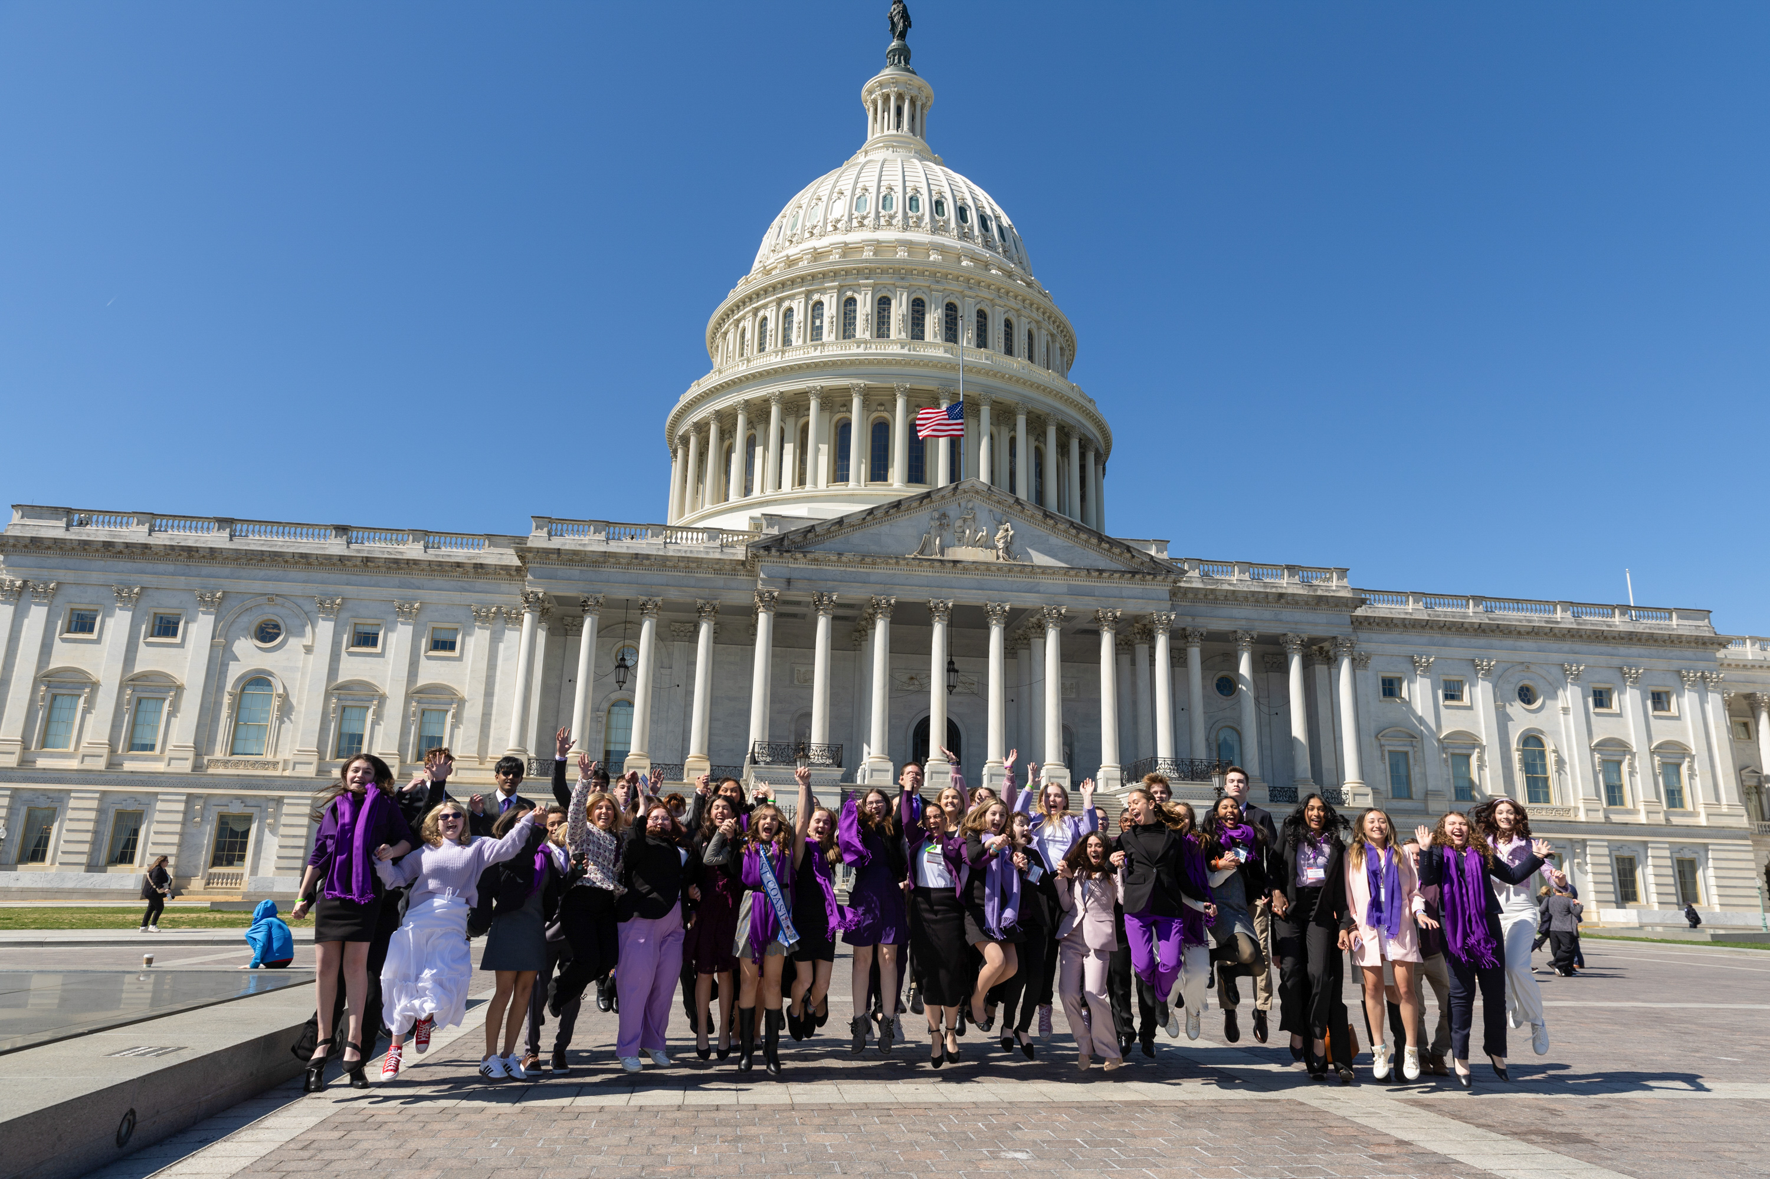
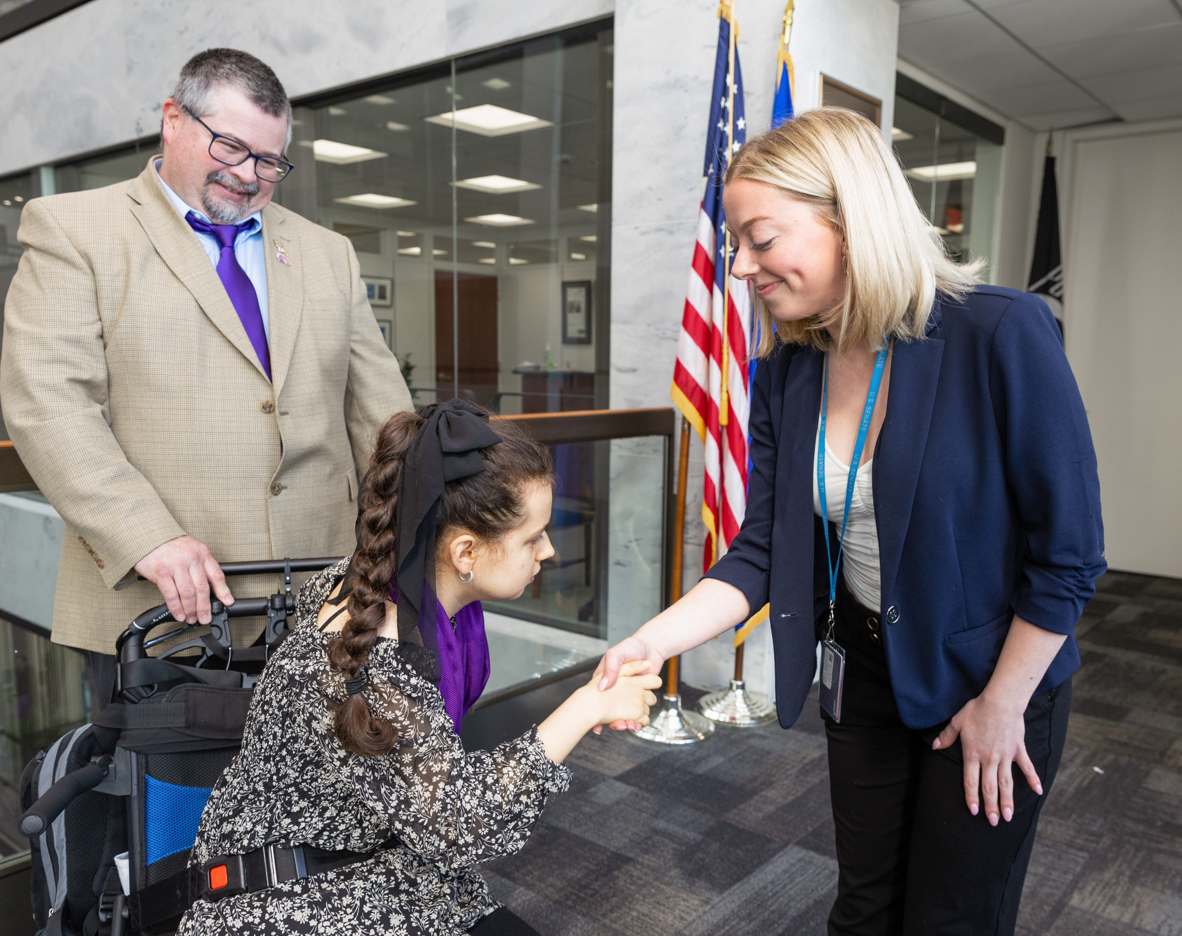
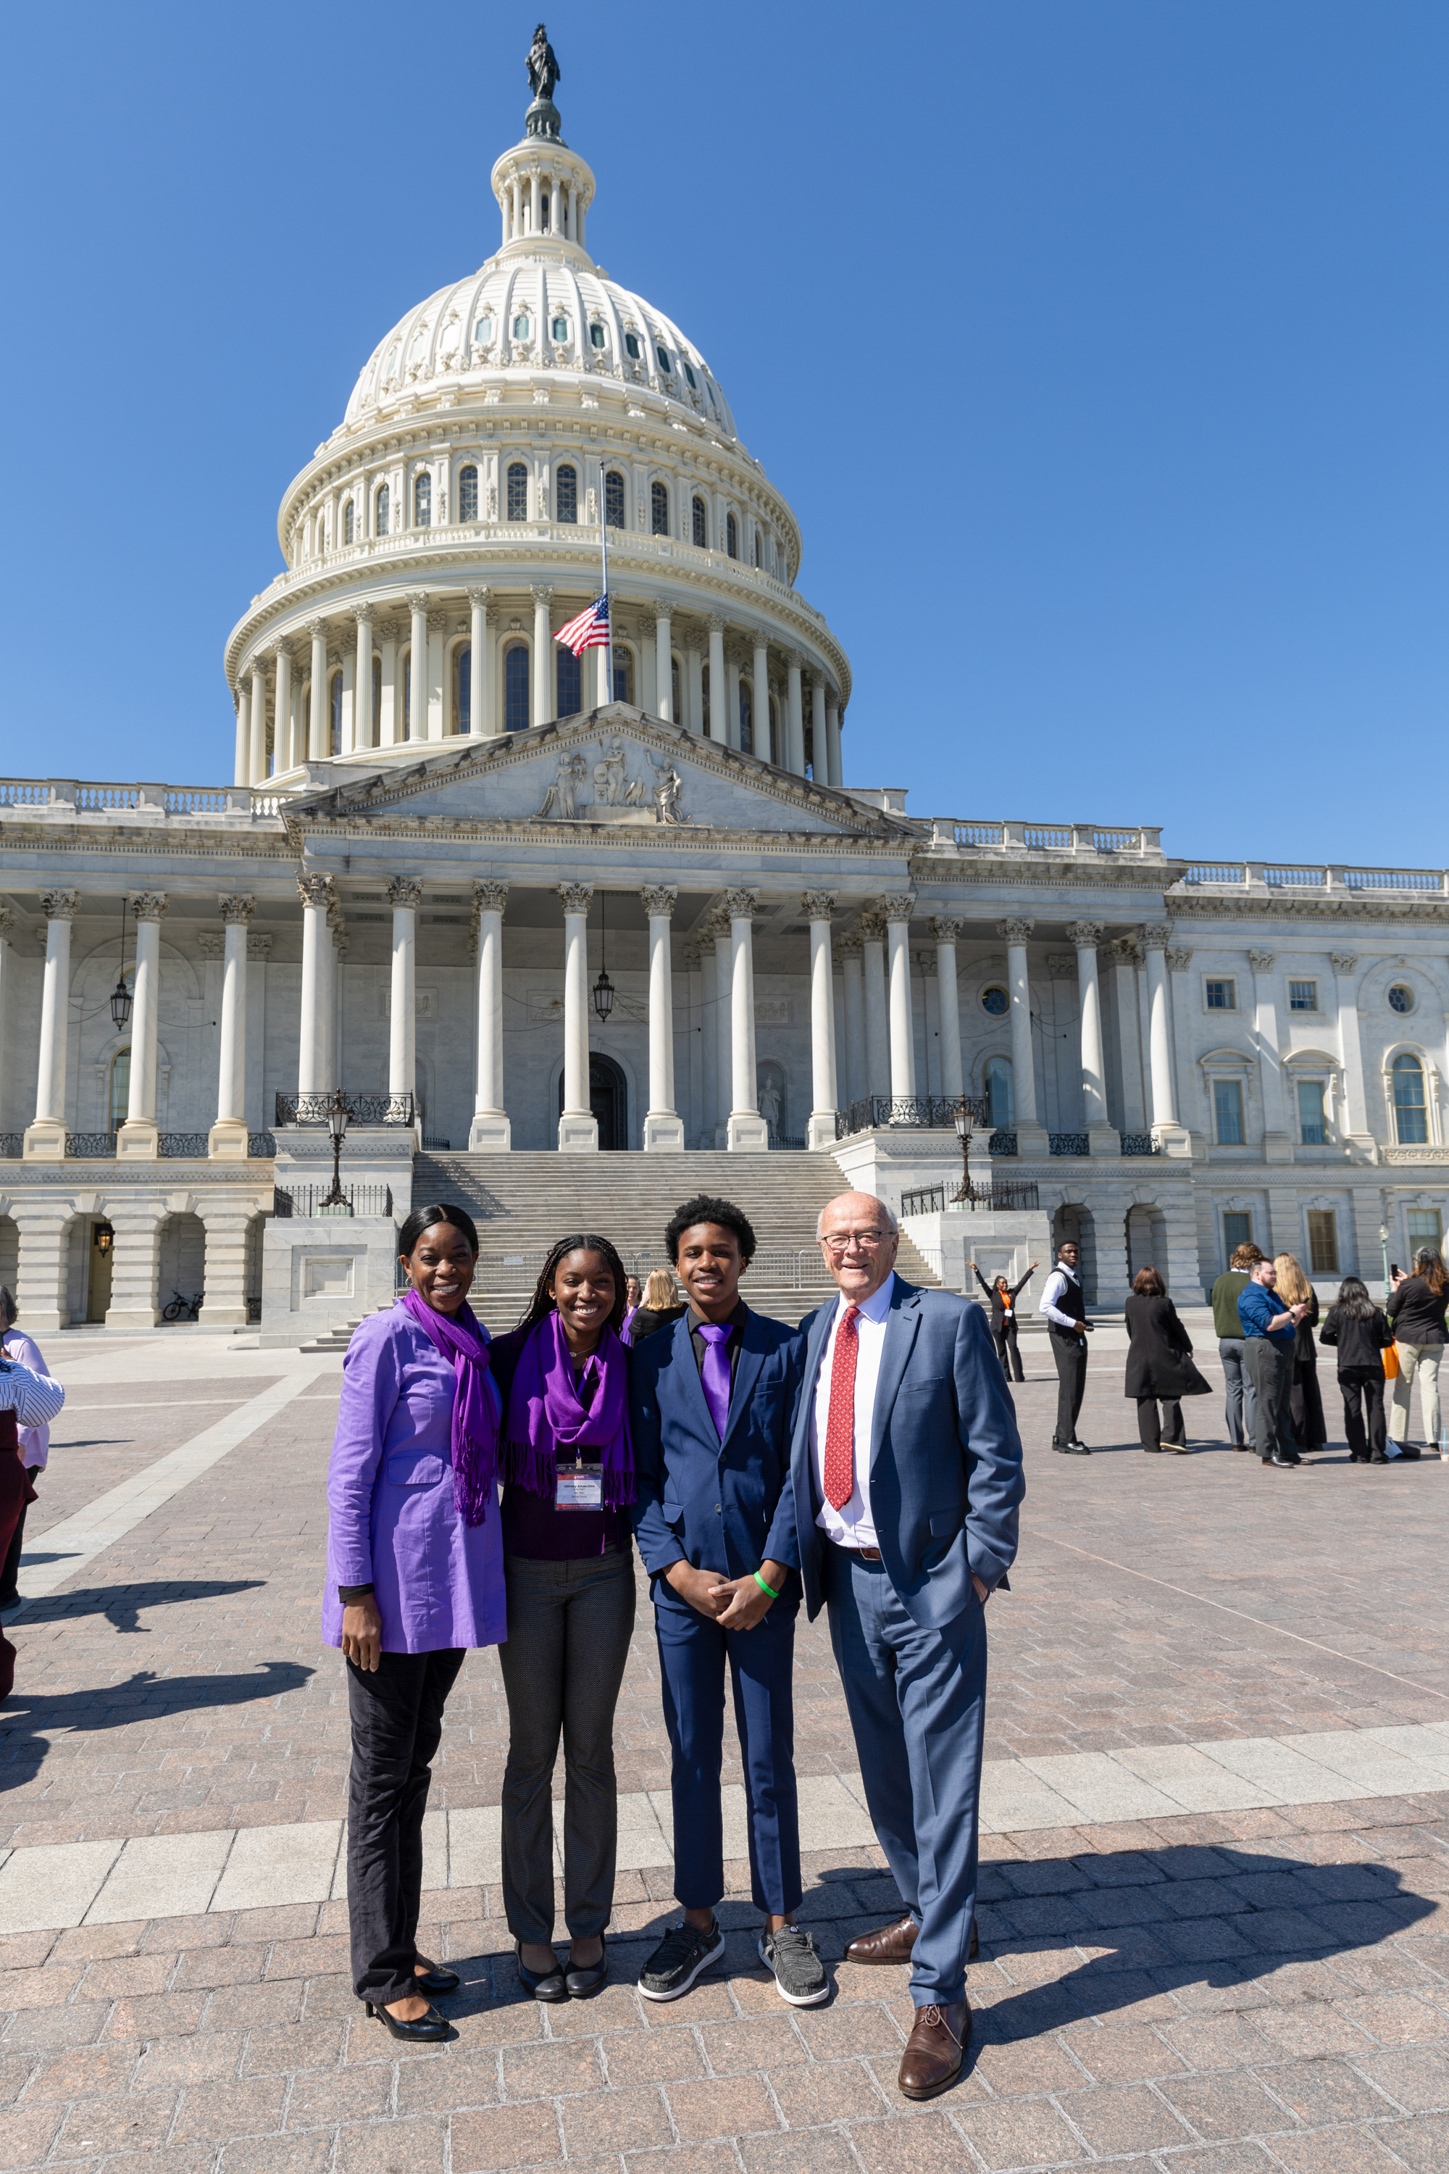
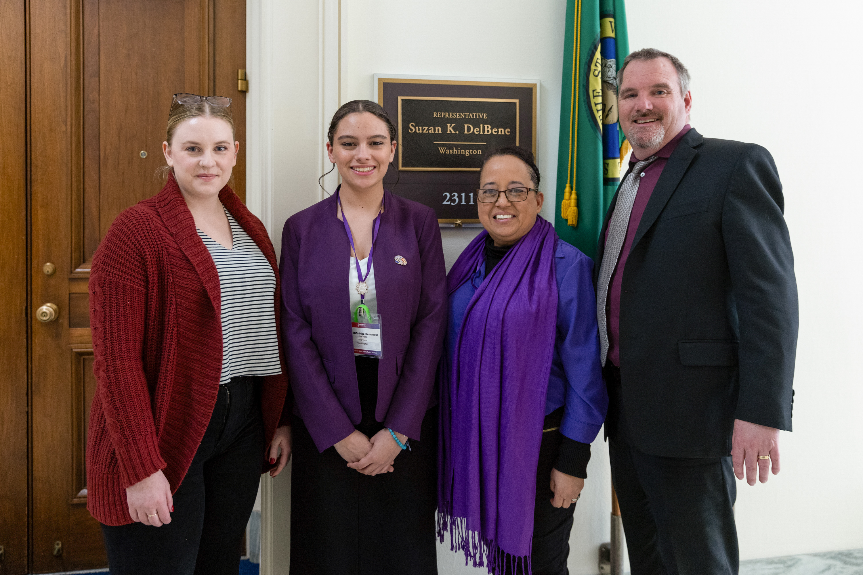
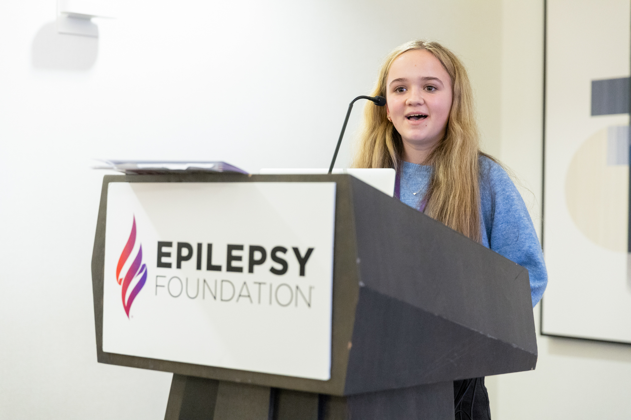
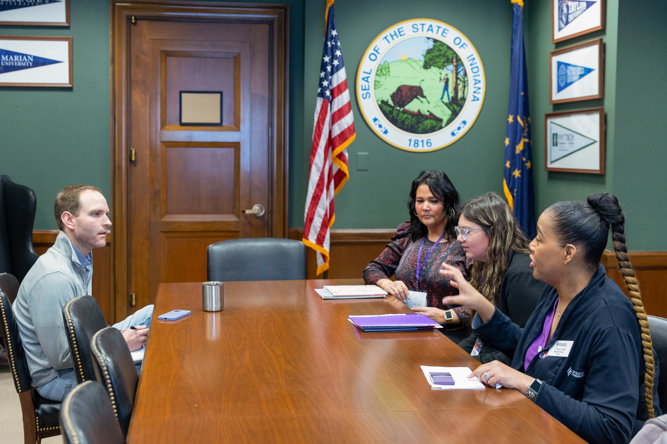
Teens Speak Up! & Public Policy Institute
Notes:
EFA has staff lobbyists and a lobbying firm that advocate on Capitol Hill constantly for the national plan.
EFA also has an annual advocacy conference and Capitol Hill Day and national plan was one of the issues we advocated for. In 2025, we had nearly 200 advocates—including 60 teenagers living with or affected by epilepsy, their parents, EF local office staff, healthcare providers, and some partner organizations participate. About 160 Hill meetings.
A few other epilepsy orgs have fly-ins and there is rare disease week which is great but hearing there is a desire for more people to go to Capitol Hill, I n 2026, EFA is aiming to invite more partner organizations to participate.

Slide 4
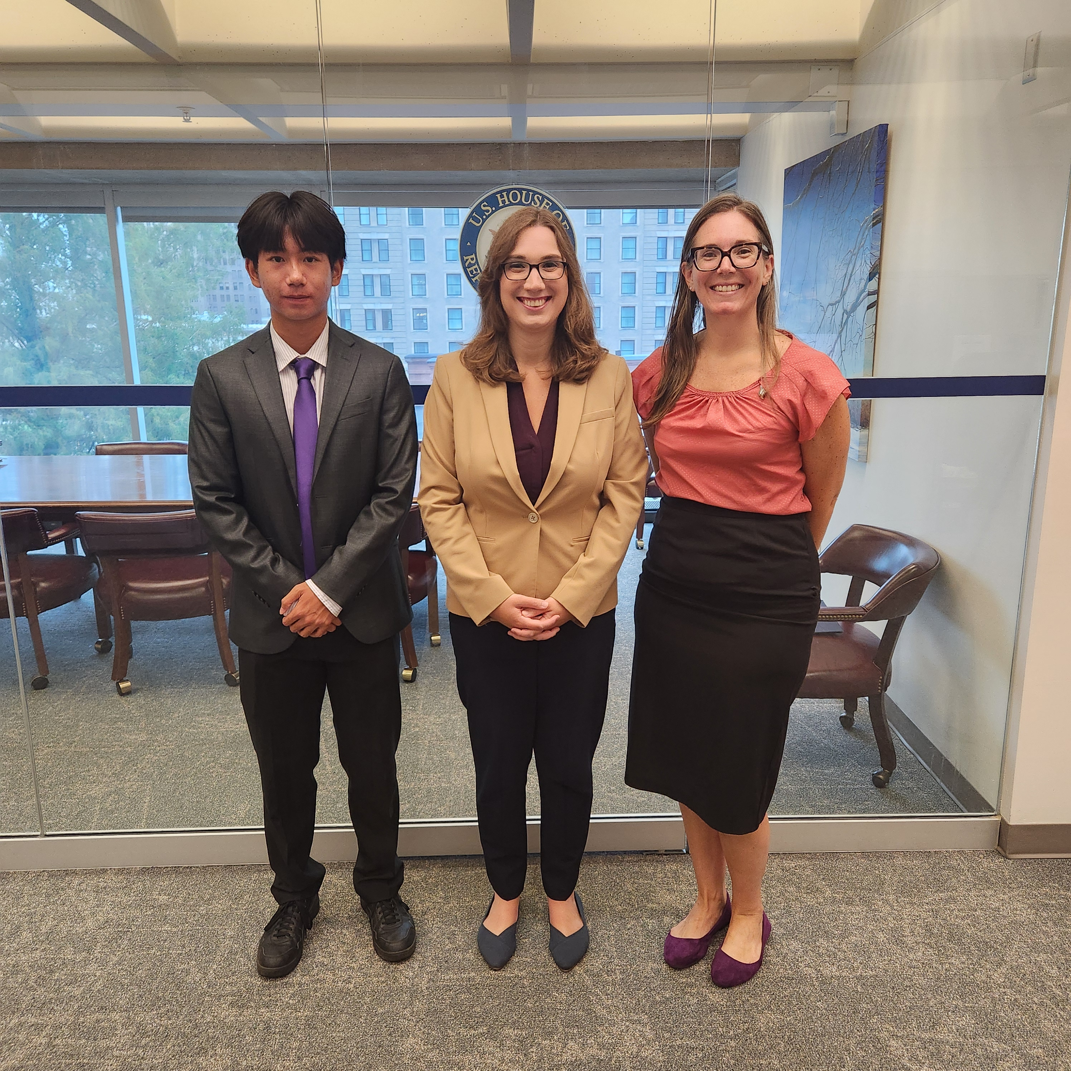
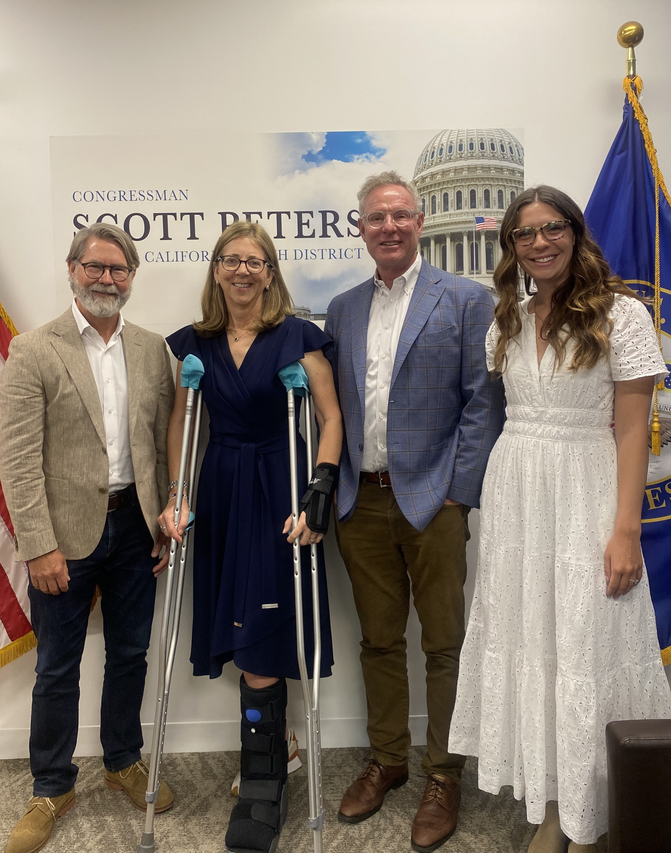
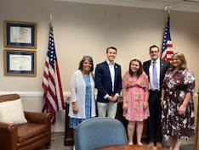
Epilepsy Advocacy Champions & Congressional August Recess Meetings
Epilepsy Advocacy Champions is EFA’s adult advocacy volunteer program. EFA provides Champions with monthly trainings and federally-focused actions for Champions; National Plan is an issue they regularly work on.
Trained and activated EF local offices, teens, and Champions to hold meetings during the Congressional August Recess; National Plan was one of the asks.
EFA provides advocates/constituents for coalition meetings
Notes:
LW

Slide 5
What Resonated & Advice
Defense & Offense
Need to protect current programs & keep driving change
No matter where we land with actual and proposed cuts, the National Plan is a way to continue focus and investment in epilepsy
Stronger Together
Members of Congress repeatedly talk about how important it is for the community to speak with one voice
Orgs can pursue unique needs—but can come together on policies like the National Plan
Just…Start!
Advocacy can seem daunting, but we are all here to support each other
Doing ANYTHING—even 1 or 2 meetings with congressional offices—is helpful!
Notes:
LW

