Slide 1
Partners Against Mortality in Epilepsy (PAME)
Advocacy Work
Alison Kukla, MPH
Senior Advisor, Outreach & Education
alison.kukla@outlook.com

Slide 2
PAME & Advocacy
Committee: Started a Legislative and Advocacy Committee in 2024 to organize around the State Policy work and grew to Federal Policy and National Plan.
PAME Policy Pillars:
Educate: Elevate the issue of epilepsy mortality and the policy changes needed to save lives – your experience informs policymaking!
Advocate: Champion policy changes that make a difference in epilepsy mortality – can range from funding needs, to legislation, to insurance coverage changes.
Build Community: Our voices are stronger together! When policymakers hear the same need expressed repeatedly, that’s when the change happens – together we’re making a difference!

Slide 3
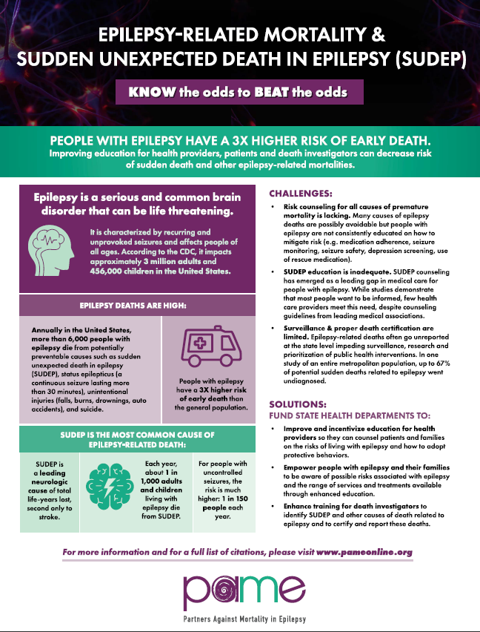
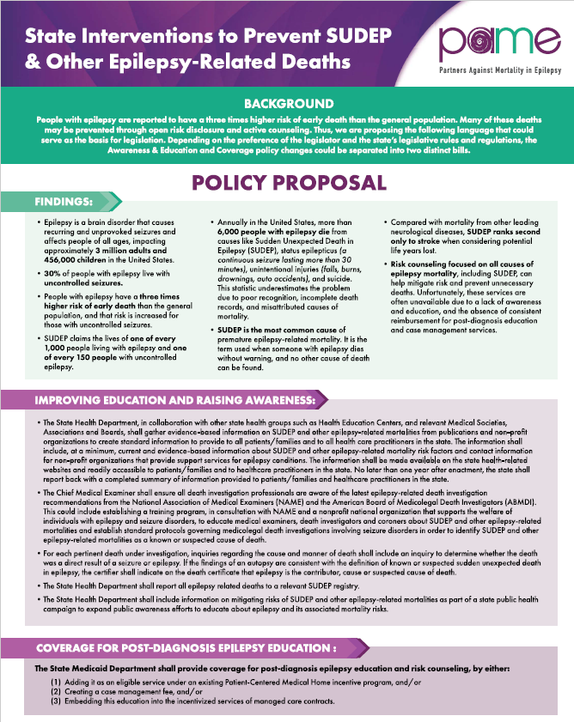
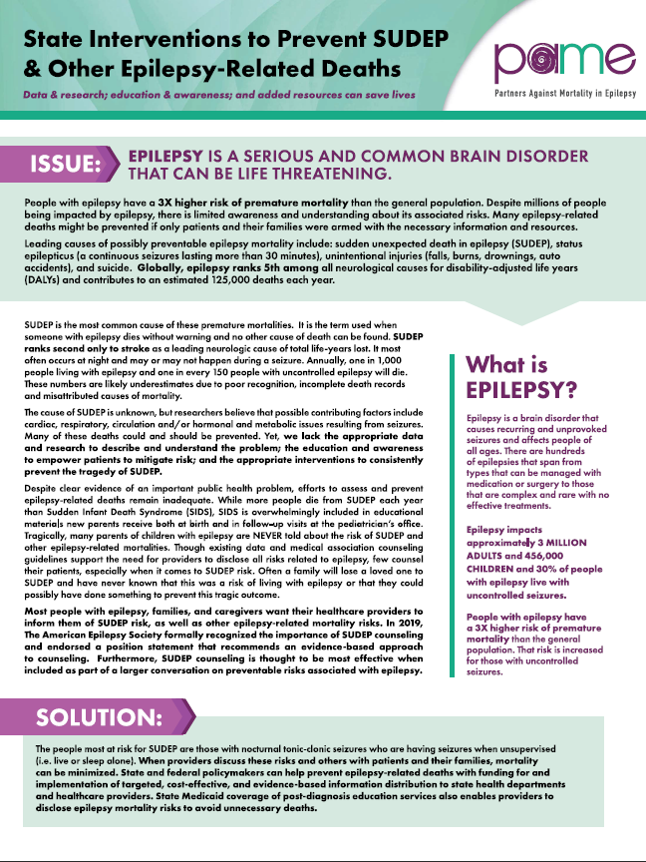
State Advocacy Toolkit
https://pameonline.org/sudep-legislative-toolkit/

Slide 4
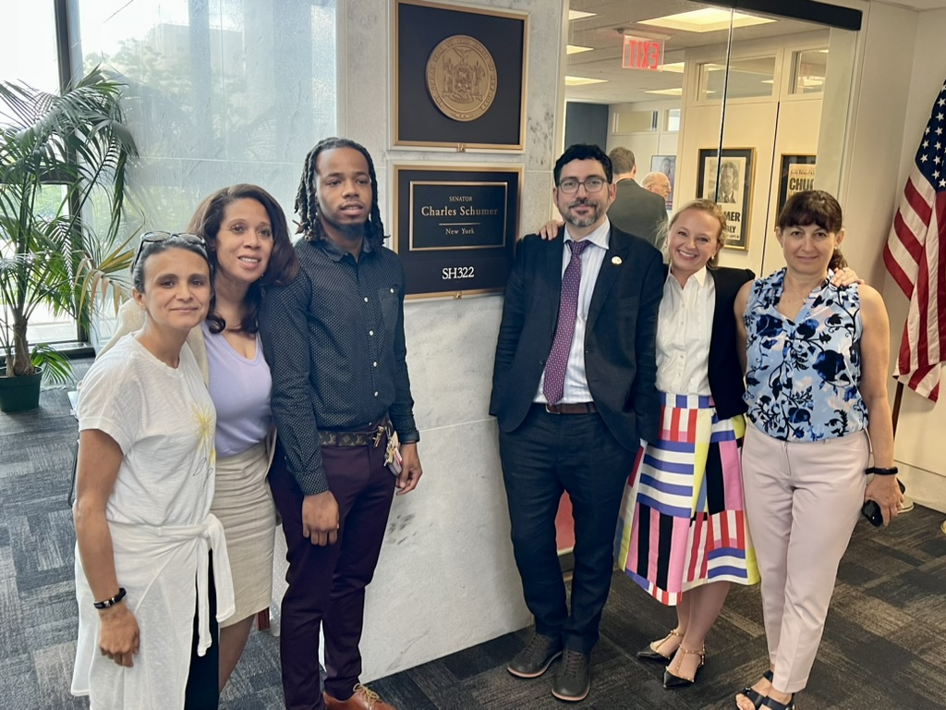
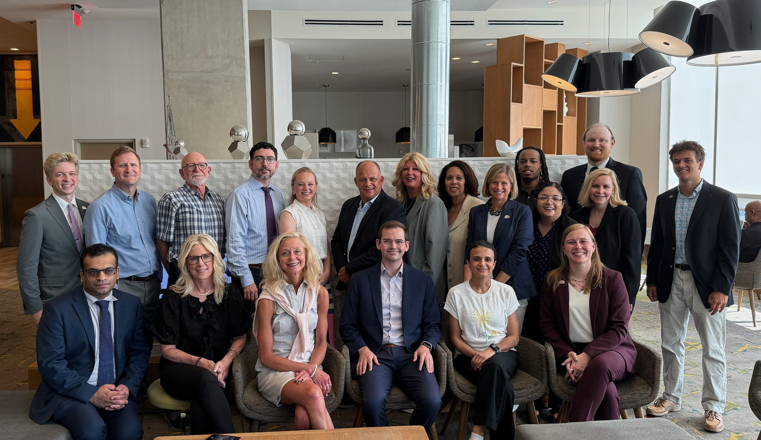
July PAME Hill Day!
YOU can influence policy change.
YOUR story matters!
26 Meetings
20 PAME Members

Slide 5

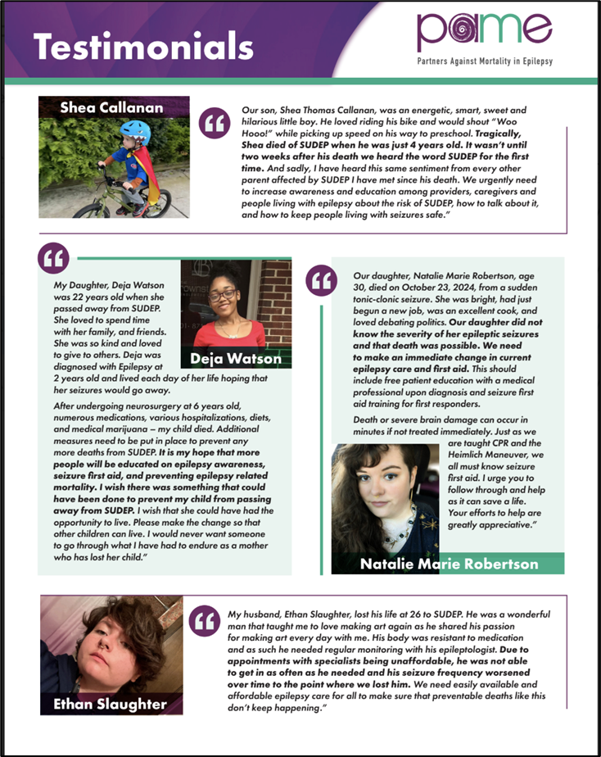

Federal One Pagers
Notes:
*Add details about one-pagers

Slide 6

Virtual Congressional Briefing.
Partnered with Co-Chairs of Congressional Epilepsy Caucus
Collaborated with other Epilepsy Organizations and Medical Professionals
255 registered, 150 attendees!
112 views on YouTube!

Slide 7
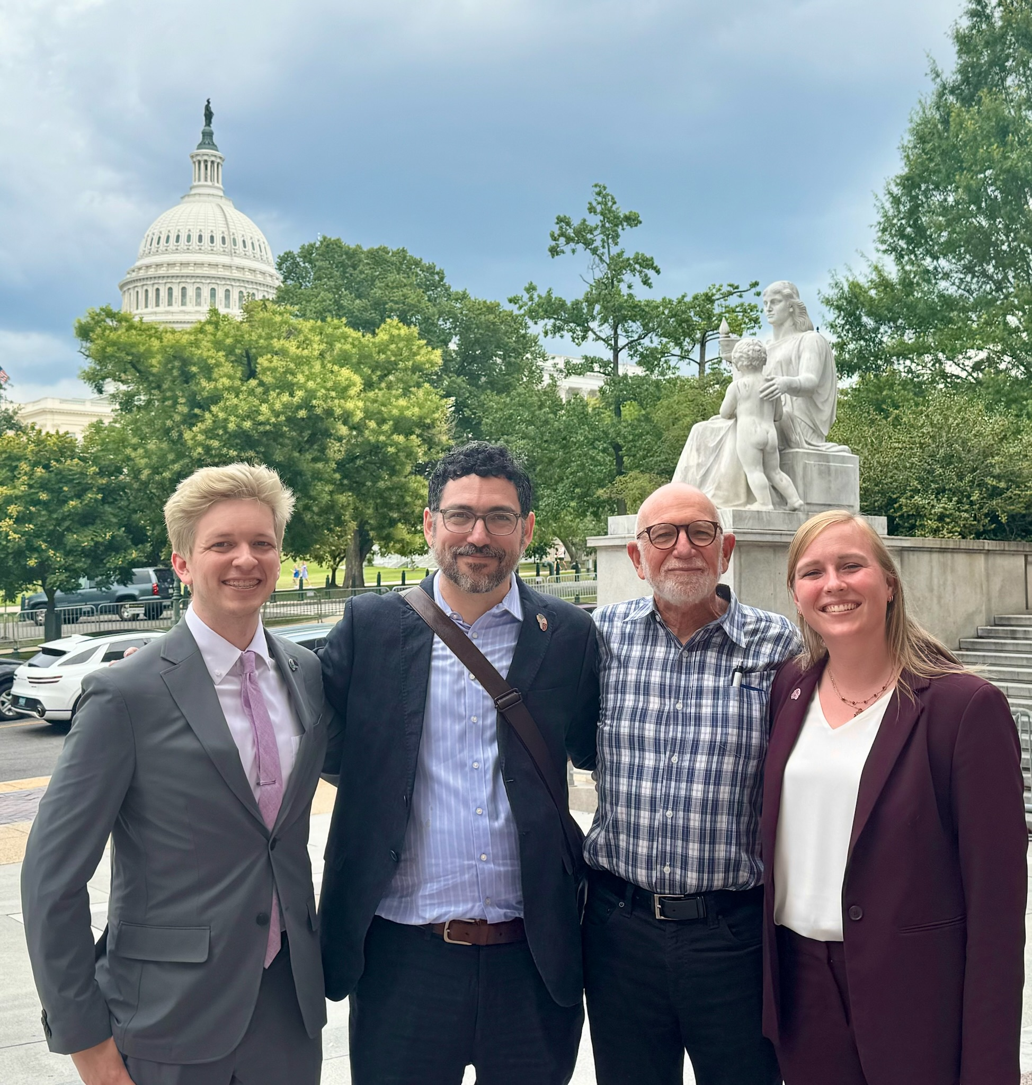
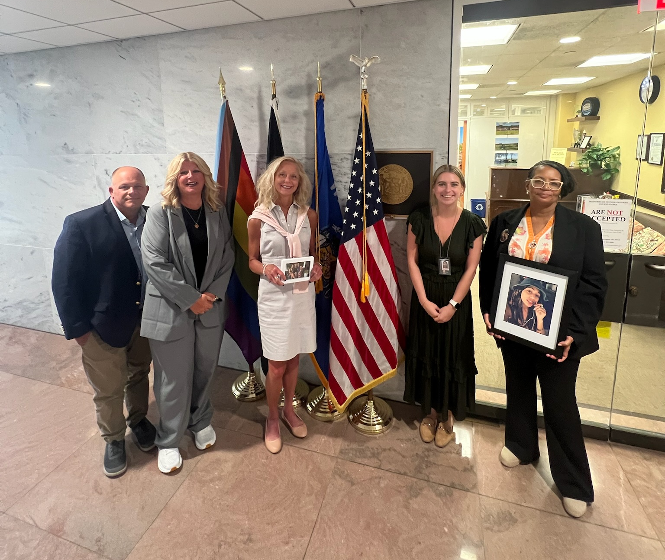
PAME’s Impact
Multiple Sign-Ons to National Plan
Community Building & Collaboration
Elevating Epilepsy Mortality Issue
Being a Resource to Community Members
Continued Outreach to Representatives
Building a State Policy Strategy

