Slide 1

CURE Epilepsy Government Advocacy
September 25, 2025

Slide 2
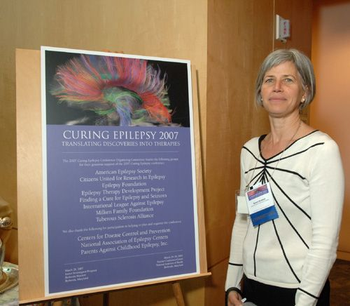


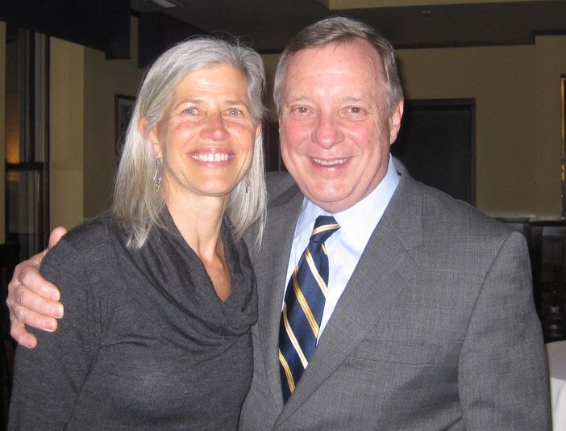
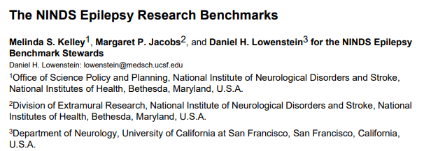
CURE Epilepsy, a long history of advocacy
Inspiring Curing Epilepsy Conferences, starting in 2000
2012
2015

Slide 3
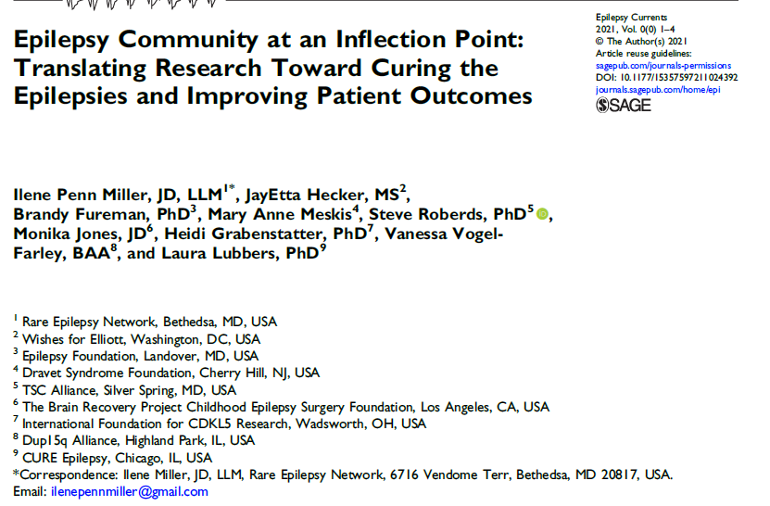
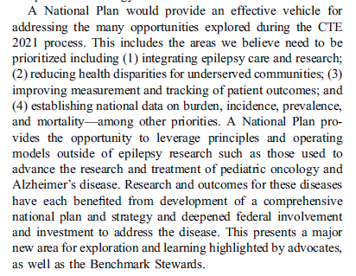
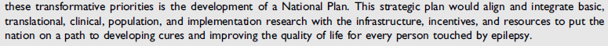
Influencing the Dialogue for a National Plan for Epilepsy

Slide 4

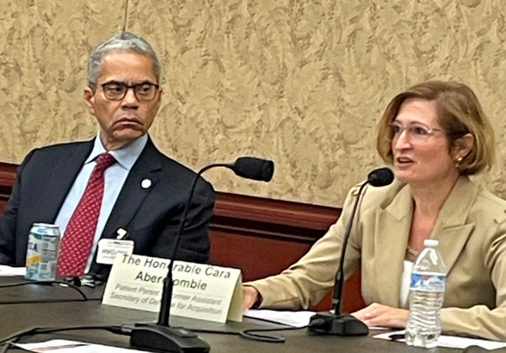
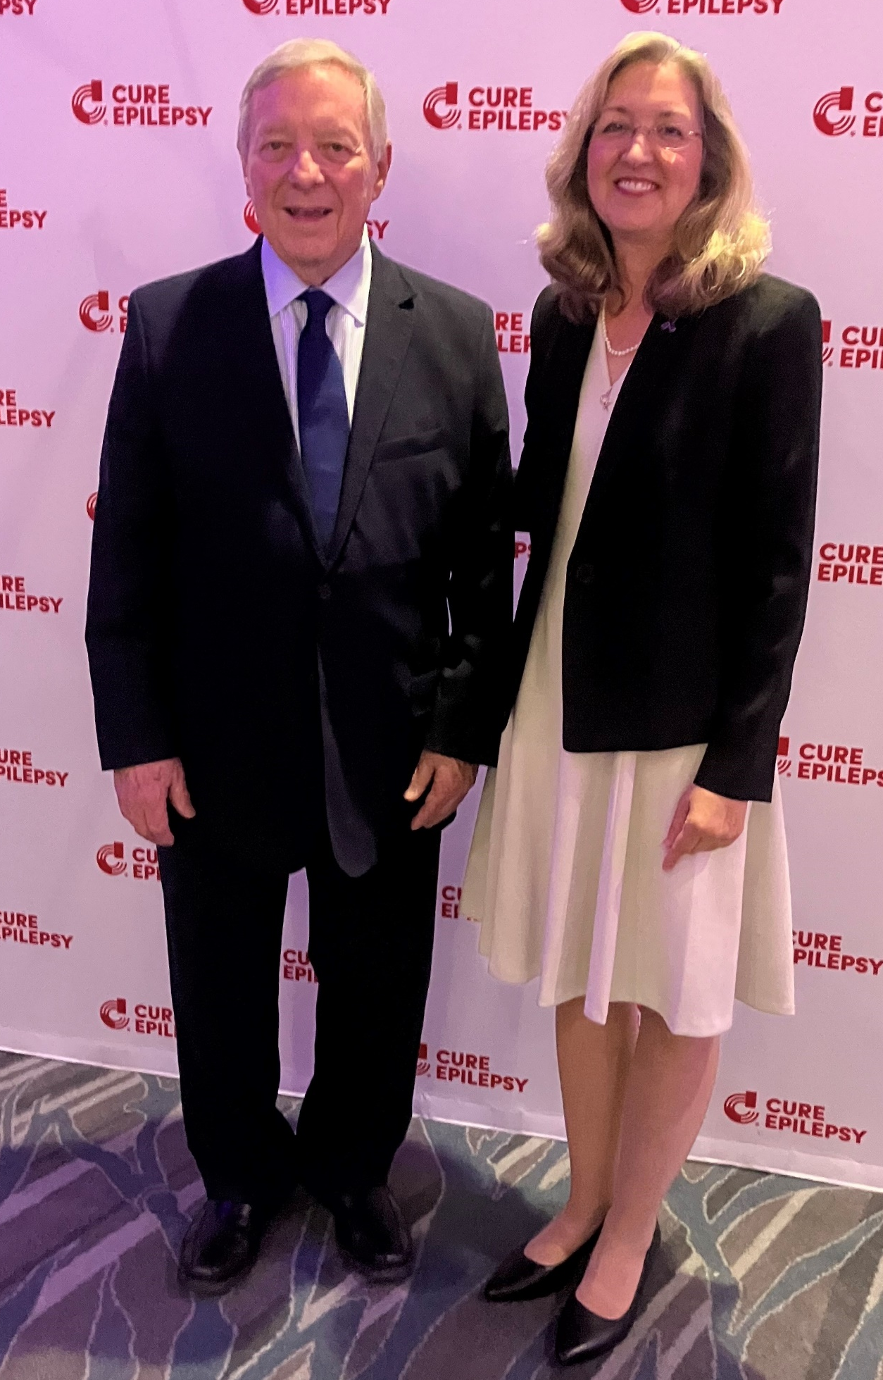
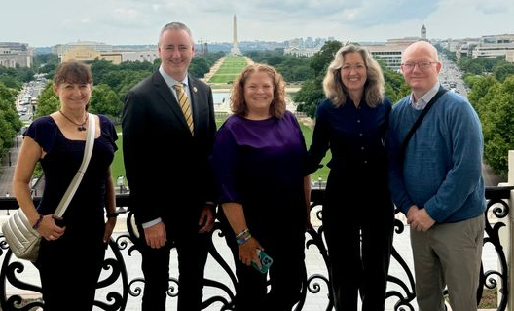
Increasing Awareness for the National Plan for Epilepsy Act
Cara Abercrombie (KPTN, CURE Epilepsy) shared her family's story explaining why Medicaid is important to rare and other families living with epilepsy during The New Democrats luncheon. She also urged support for the National Plan.
Maintaining and building relationships with Members of Congress
Kelly Cervantes interviewed Dr. Dan Lowenstein on the Seizing Life Podcast. Dr. Lowenstein discussed current efforts to push Congress to adopt a National Plan for Epilepsy, explaining who is behind it, what it is, and what it could mean to the epilepsy community.

Slide 5
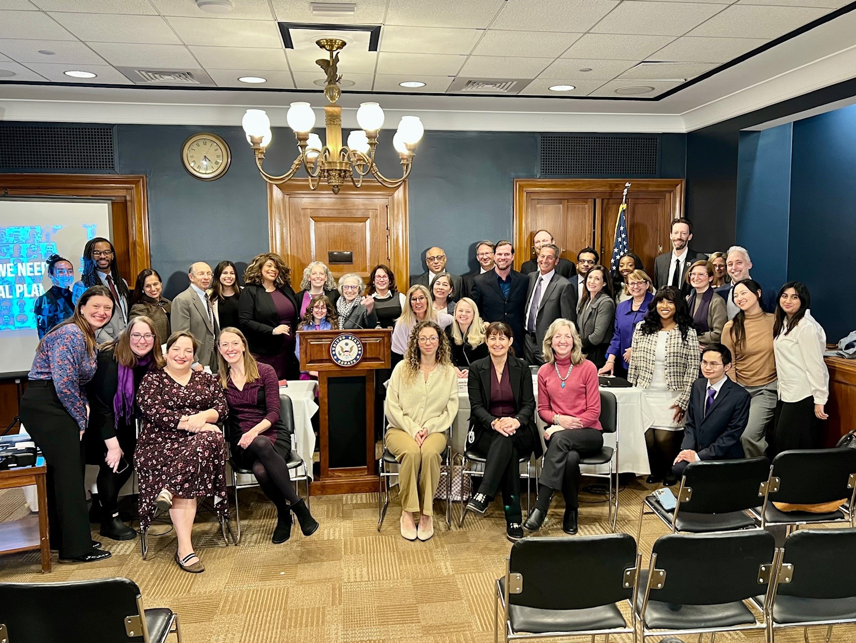
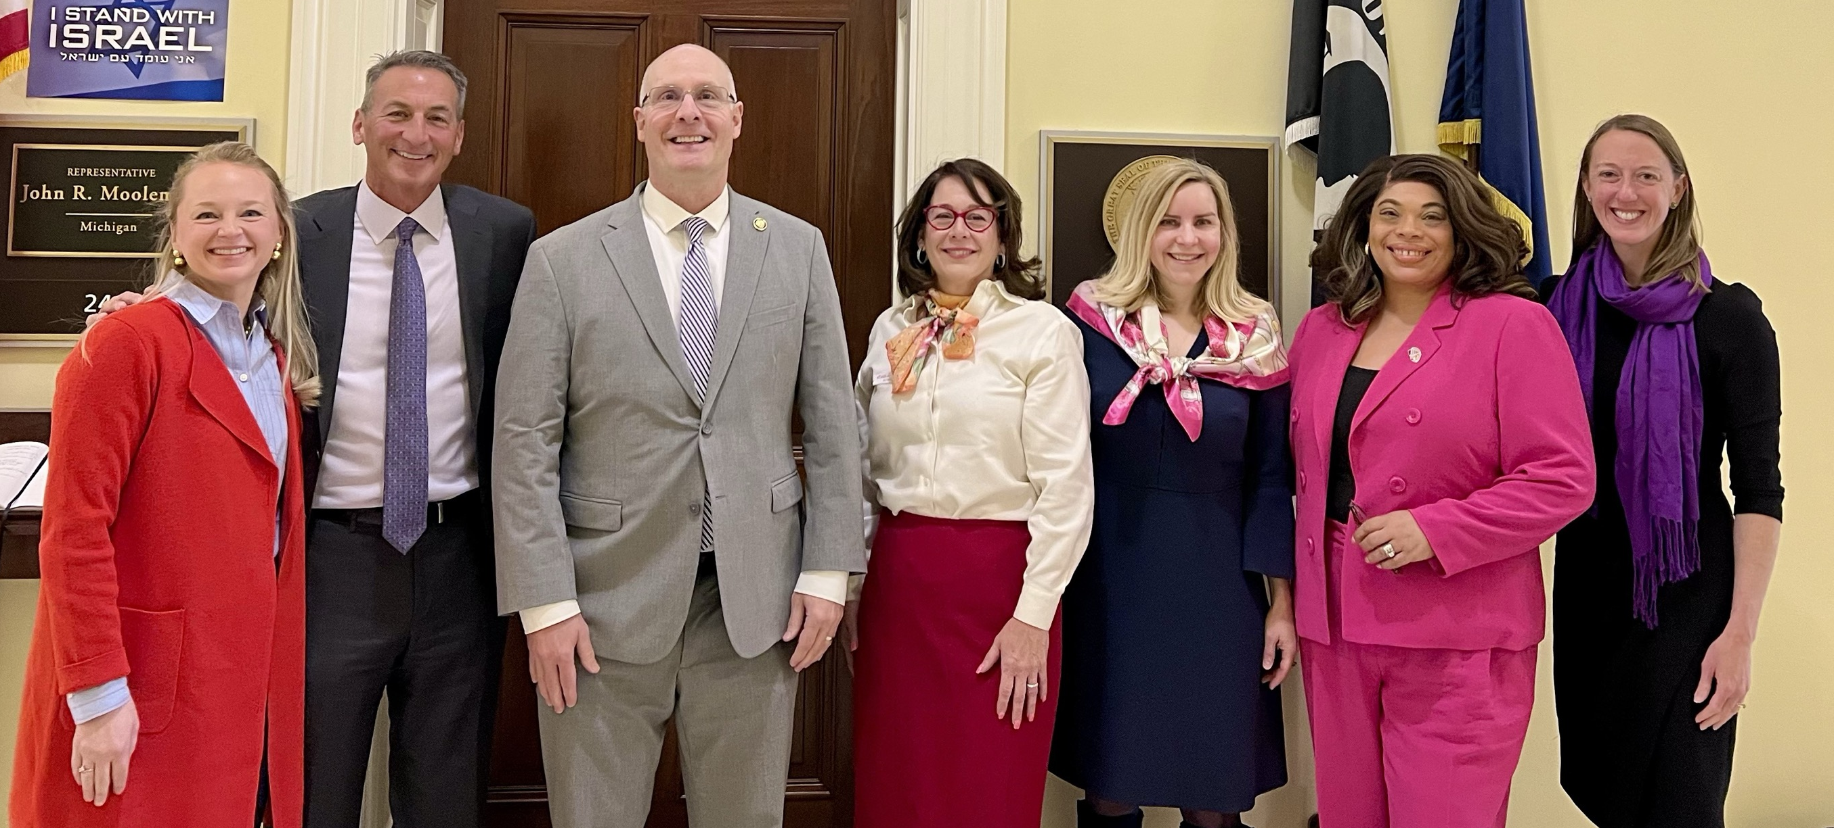
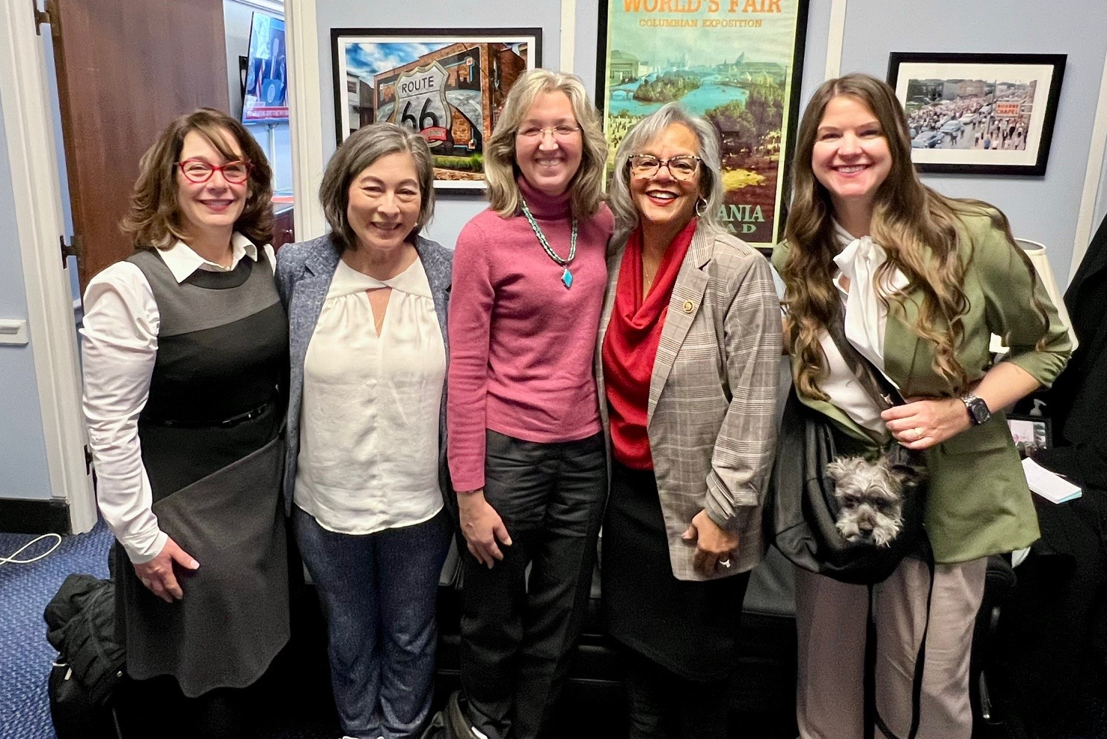
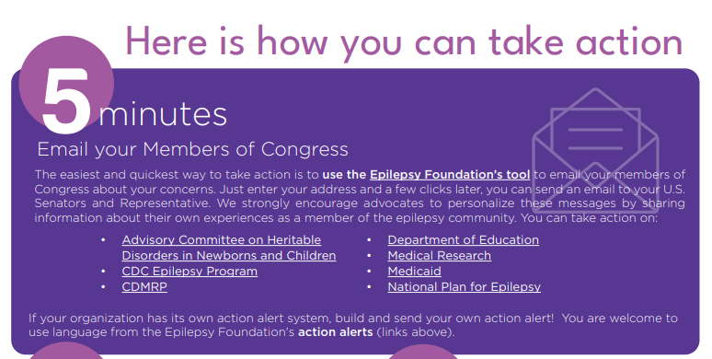
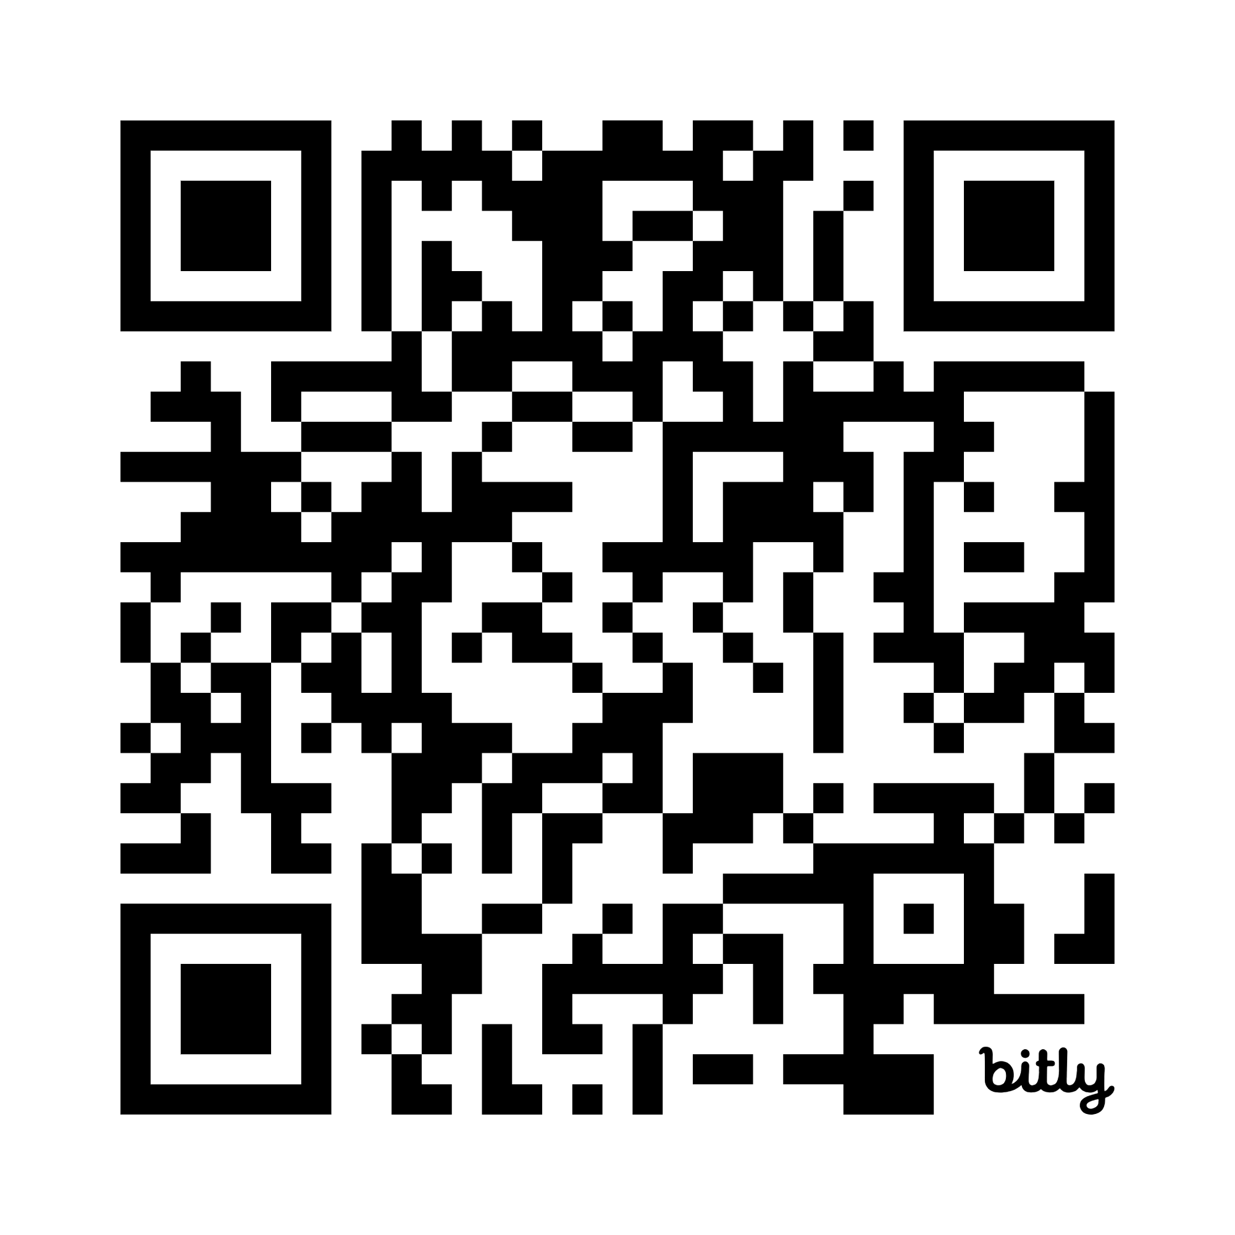
Continued Government Advocacy Through Partnerships with Others
Yet CURE Epilepsy does not have formal advocacy team. Our approach is to:
Build an internal strategy for how we can increase awareness based on our network of Board members and their connections to members of Congress
Use the Epilepsy Community Advocacy Tool Kit
Partner with Epilepsies Action Network and others on office visits and Capitol Hill opportunities
Katie Collins
Ilene Miller
3 Asks
Support research on epilepsy and work to restore lost funding
Join the epilepsy caucus
Sign onto the National Plan for Epilepsy Act

